Slide 1
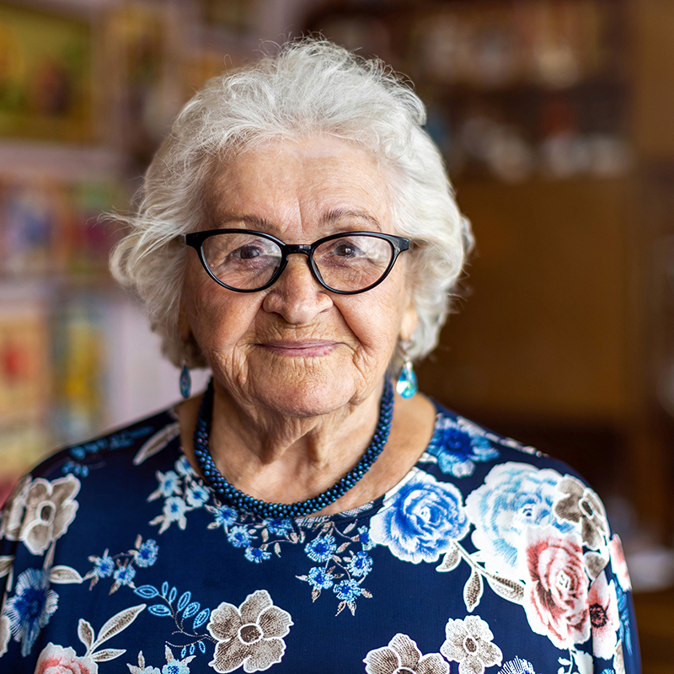
Advantage Dual Special Needs Plan (D-SNP)
CY 2026 Model of Care (MOC) Training Third Party Entities
October 2025

Slide 2
CY 2026 MODEL OF CARE TRAINING
Completing Annual Training
Since our Health Plan provides Dual Special Needs Plan (D-SNP) insurance to some of our membership, completion of annual Model of Care training is a requirement of Centers for Medicare and Medicaid Services (CMS).
Your attendance and completion will be tracked each year.​
You must view every slide of this training to receive a successful completion status​
An attestation of the completion of this training is required.

Slide 3
CY 2026 MODEL OF CARE TRAINING
Objectives
Objectives for this annual training are:
Provide an overview of the Model of Care (MOC) structure to third party entities that may interact with D-SNP members on a routine basis​
Understand the Care Management goals for members of the provider network​
Identify key roles and departments that support the MOC at Health Plan
Understand the role of an interdisciplinary care team for HPSJ’s Special Needs Plan members

Slide 4

Introduction

Slide 5
CY 2026 MODEL OF CARE TRAINING
Introduction
The Centers for Medicare & Medicaid Services (CMS) requires all Medicare Advantage Special Needs Plans (SNPs) to have a Model of Care (MOC)
The health plan is required to submit information to the Centers of Medicare & Medicaid Services (CMS) and to the Department of Health Care Services (DHCS) every year, including Model of Care plan information, and records of initial and annual training for employees, providers, and third party entities.

Slide 6
CY 2026 MODEL OF CARE TRAINING
Definitions of Special Needs Plans (SNP)
Medicare Advantage (MA) coordinated care plans (CCPs) for special needs individuals, referred to as special needs plans (SNPs). There are three types of SNPs, each with restricted enrollment:
Chronic Condition SNPs: individuals with specific severe or disabling chronic conditions
Dual Eligible SNPs: individuals who are entitled to both Medicare (title XVIII) Medicaid (title XIX)
Institutional SNPs: individuals who, for >90 days, have had/are expected to need the level of services provided in a long-term care (LTC) skilled nursing facility (SNF), a LTC nursing facility (NF), a SNF/NF, an intermediate care facility for individuals with intellectual disabilities (ICF/IDD), or an inpatient psychiatric facility.

Slide 7
CY 2026 MODEL OF CARE TRAINING
Definitions of Special Needs Plans (SNP)
Model of Care (MOC):
Provides the basic framework through which the SNP will meet the needs of each of its enrollees.
Is a vital quality improvement tool and integral component for ensuring that the unique needs of each enrollee are identified by the SNP and addressed through the plan’s care management practices.
Provides the foundation for promoting SNP quality, care management, and care coordination processes.

Slide 8
CY 2026 MODEL OF CARE TRAINING
Health Plan’s D-SNP Eligibility Requirements
Requirements for Eligibility:
Live in the Health Plan’s approved geographic service area of Alpine, El Dorado, San Joaquin or Stanislaus County
Enrolled in Medicare Part A
Enrolled in Medicare Part B
Qualify for both Medicare and Medi-cal

Slide 9

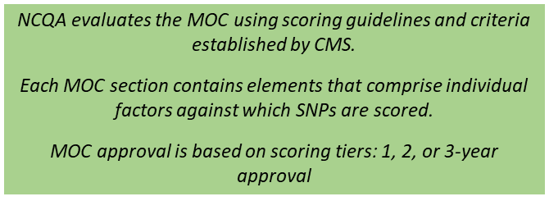
CY 2026 MODEL OF CARE TRAINING
How the MOC is Organized
The SNP MOC is organized around four sections:
MOC 1: Description of the SNP Population | MOC 2: Care Coordination
MOC 3: Provider Network | MOC 4: Quality Measurement & Performance Improvement

Slide 10

MOC 1: Description of SNP Population

Slide 11
CY 2026 MODEL OF CARE TRAINING
Description of Overall SNP Population
Determine, verify, and track enrollee eligibility
Understand health status and disparities of the D-SNP population
Identify demographics of D-SNP enrollees
Define the unique characteristics of the Health Plan D-SNP population

Slide 12
CY 2026 MODEL OF CARE TRAINING
Identify Health Plan’s Most Vulnerable D-SNP Enrollees
Define and identify most vulnerable members
Describe factors contributing to health outcomes of most vulnerable
Demonstrate the relationship between demographic characteristics and the clinical requirements of most vulnerable members
Establish partnerships with community-based organizations to facilitate access and deliver specially-tailored services to most vulnerable enrollees

Slide 13
CY 2026 MODEL OF CARE TRAINING
California DHCS Requirements
In the 2026 CalAIM Dual Eligible SNP Policy Guide, DHCS defines additional vulnerable populations and requirements:
In its 2026 MOC, Health Plan defines its “most vulnerable subpopulations” consistent with the DHCS California Integrated Care Management (CICM) requirements. CICM replaces ECM and “ECM-like care management” requirements for D-SNPs.
The Health Plan must provide robust care coordination for all SNP enrollees, and identifies the following subpopulations as its most vulnerable, consistent with the DHCS CICM definitions:
Adults Experiencing Homelessness | Adults At Risk for Avoidable Hospital or Emergency Department Utilization
Adults with Serious Mental Health and/or Substance Use Disorder (SUD) | Adults Transitioning from Incarceration
Adults Living in the Community and At Risk for Long-Term Care (LTC) Institutionalization | Adults Nursing Facility Residents Transitioning to the Community
Adults who are Pregnant or Postpartum and Subject to Racial and Ethnic Disparities | Adults with Documented Dementia Needs

Slide 14

MOC 2: Care Coordination

Slide 15
CY 2026 MODEL OF CARE TRAINING
Specific Care Coordination Goals for D-SNP
Aspects of Care:
Use of Health Risk Assessments to determine needs
Facilitating access to essential services, affordable care and health services
Provide for face-to-face encounters for the delivery of health care, care management, or care coordination services
Development of an individualized care plan
Coordination of care through use of an interdisciplinary care team
Transitional care across settings, providers, and health services
Appropriate utilization of services
Improving health outcomes

Slide 16
CY 2026 MODEL OF CARE TRAINING
SNP Staff Structure
Roles and Responsibilities that affect care coordination of SNP Enrollees
Supervision and oversight
Administrative
Contingency plans and business continuity
Clinical
Training
Sales & Marketing
Enrollment
Eligibility Verification
Member Services
Claims
Contracting
Regulatory Compliance
Quality Management Care Coordination Utilization Management
Appeals & Grievances
Pharmacy Consultation & BH Counseling

Slide 17
CY 2026 MODEL OF CARE TRAINING
Health Risk Assessment (HRA)
Conduct Initial HRA within 90 days of enrollment
Use Initial and Annual HRA as foundation for development of Individualized Care Plan (ICP)
Share HRA findings with Interdisciplinary Care Team (ICT)
Review HRA findings to analyze and stratify and communicate results to ICT, PCP and others

Slide 18
CY 2026 MODEL OF CARE TRAINING
Face-to-Face Encounter
Face-to-face encounters must:
Occur at least annually beginning in the first 12 months of enrollment​
Be between each enrollee and a member of the enrollee’s ICT, the plan’s case management and coordination staff or contracted plan health care providers​
In-person, or real-time virtual​
Have a defined intended outcome​
Include clinical functions, assessments or services specified in the MOC​
Be used to identify and address health concerns​
Be used to activate care coordination follow ups (e.g., referrals, etc.)

Slide 19
CY 2026 MODEL OF CARE TRAINING
Individualized Care Plan (ICP)
Includes member goals and preferences, services tailored to meet needs and “SMART” goal statements
Documented and maintained in CM software application
Reviewed and modified at least annually and when change in needs occurs
Developed by clinical staff for each enrollee, using HRA responses and other available information
Is communicated to member and other stakeholders
(e.g., ICT)

Slide 20
CY 2026 MODEL OF CARE TRAINING
Interdisciplinary Care Team (ICT)
Composition of ICT is specific to member needs:
All DSNP members have care coordinated by an ICT
Composition based on member needs and includes member/caregiver, PCP and other providers
ICT members have distinct roles and responsibilities
ICT members use outcomes to evaluate and continually improve health status of members
ICT members exchange member information regularly
The member's Primary Care Provider is an important contributing member of the ICT

Slide 21
CY 2026 MODEL OF CARE TRAINING
Interdisciplinary Care Team (ICT)
Member Participation
Member receives a “Welcome Letter”
Outreach by case management staff to conduct HRA by telephone
Member/caregiver encouraged to participate in care plan development and ICT
Case Manager communicates with member/caregiver to discuss care coordination program and individualized care plan
Member/caregiver encouraged to inform plan for new or changes in condition
Ongoing communication amongst ICT members is coordinated / ICT meetings as needed

Slide 22
CY 2026 MODEL OF CARE TRAINING
Interdisciplinary Care Team (ICT)
Member/ Caregiver/
Authorized Representative
PCP, Specialists, Providers, Pharmacist, DME, Medical Supplier, Community-based Organizations
Clinical Team
RN Case Managers, SW Case Managers, Medical Directors/Physician Advisors, Behavioral Health Professionals
Member care plan must be administered through the ICT
Invitees may participate in meeting or may decline
Member care plan is reviewed and revised during ICT meeting, with or without member and/or external participants
To reach Health Plan care coordination staff call: 800-822-6226 for assistance with member care issues

Slide 23
CY 2026 MODEL OF CARE TRAINING
Care Transition Protocols
Care Transition Protocol
Applicable to all enrollees
Planned and unplanned transitions
Designated Care Manager
Coordinates care transition
Members provided with
Information about point of contact through transition
In and out-of-network
Used to maintain continuity of care
Transfers elements of ICP between settings
Information for accessing PHI
Education about health status and self-management tool

Slide 24
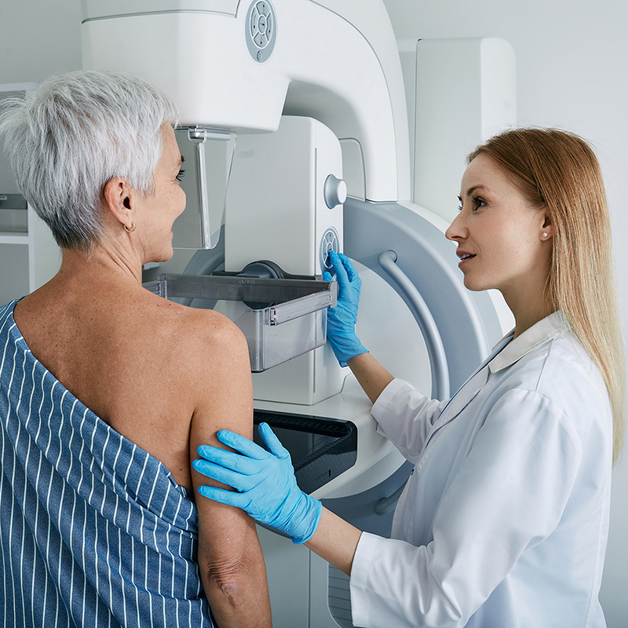
MOC 3: Provider Network

Slide 25
CY 2026 MODEL OF CARE TRAINING
Specialized Expertise
Network
The network must include providers with specialized expertise that corresponds to target population (i.e., duals)
Oversight of Network
The SNP credentials and recredentials practitioners and facilities
Collaboration
Providers are expected to collaborate with the ICT and contribute to the care plan
Provider Directory
The SNP documents, updates, and maintains accurate provider information

Slide 26
CY 2026 MODEL OF CARE TRAINING
Clinical Practice Guidelines (CPGs)
Care Transition Protocols (CTPs)
CPGs
The SNP adopts CPGs to promote evidence-based care, and monitors network provider use of CPGs
Challenges to using CPGs
The SNP modifies CPGs when they are inappropriate for the population or service area
CTPs
The SNP ensures continuity of care across transitions (in and out-of-network)
Communication of modified CPGs
When CPGs are modified, changes communicated and acted upon

Slide 27
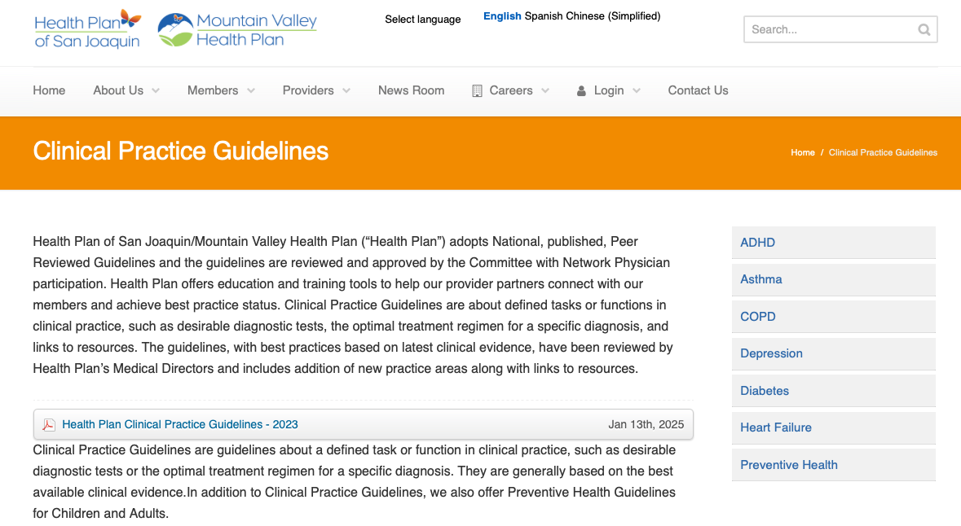
CY 2026 MODEL OF CARE TRAINING
Clinical Practice Guidelines
Available on Health Plan Website

Slide 28
MOC Training for Providers
Training required for
Contracted providers
Out-of-network providers who see members on a routine basis
Evidence of Training
SNP documents evidence of training delivery to providers
Address challenges associated with training
Contracted providers, and
Out-of-network providers
Actions taken when
Training is deficient
A provider has not completed required

Slide 29
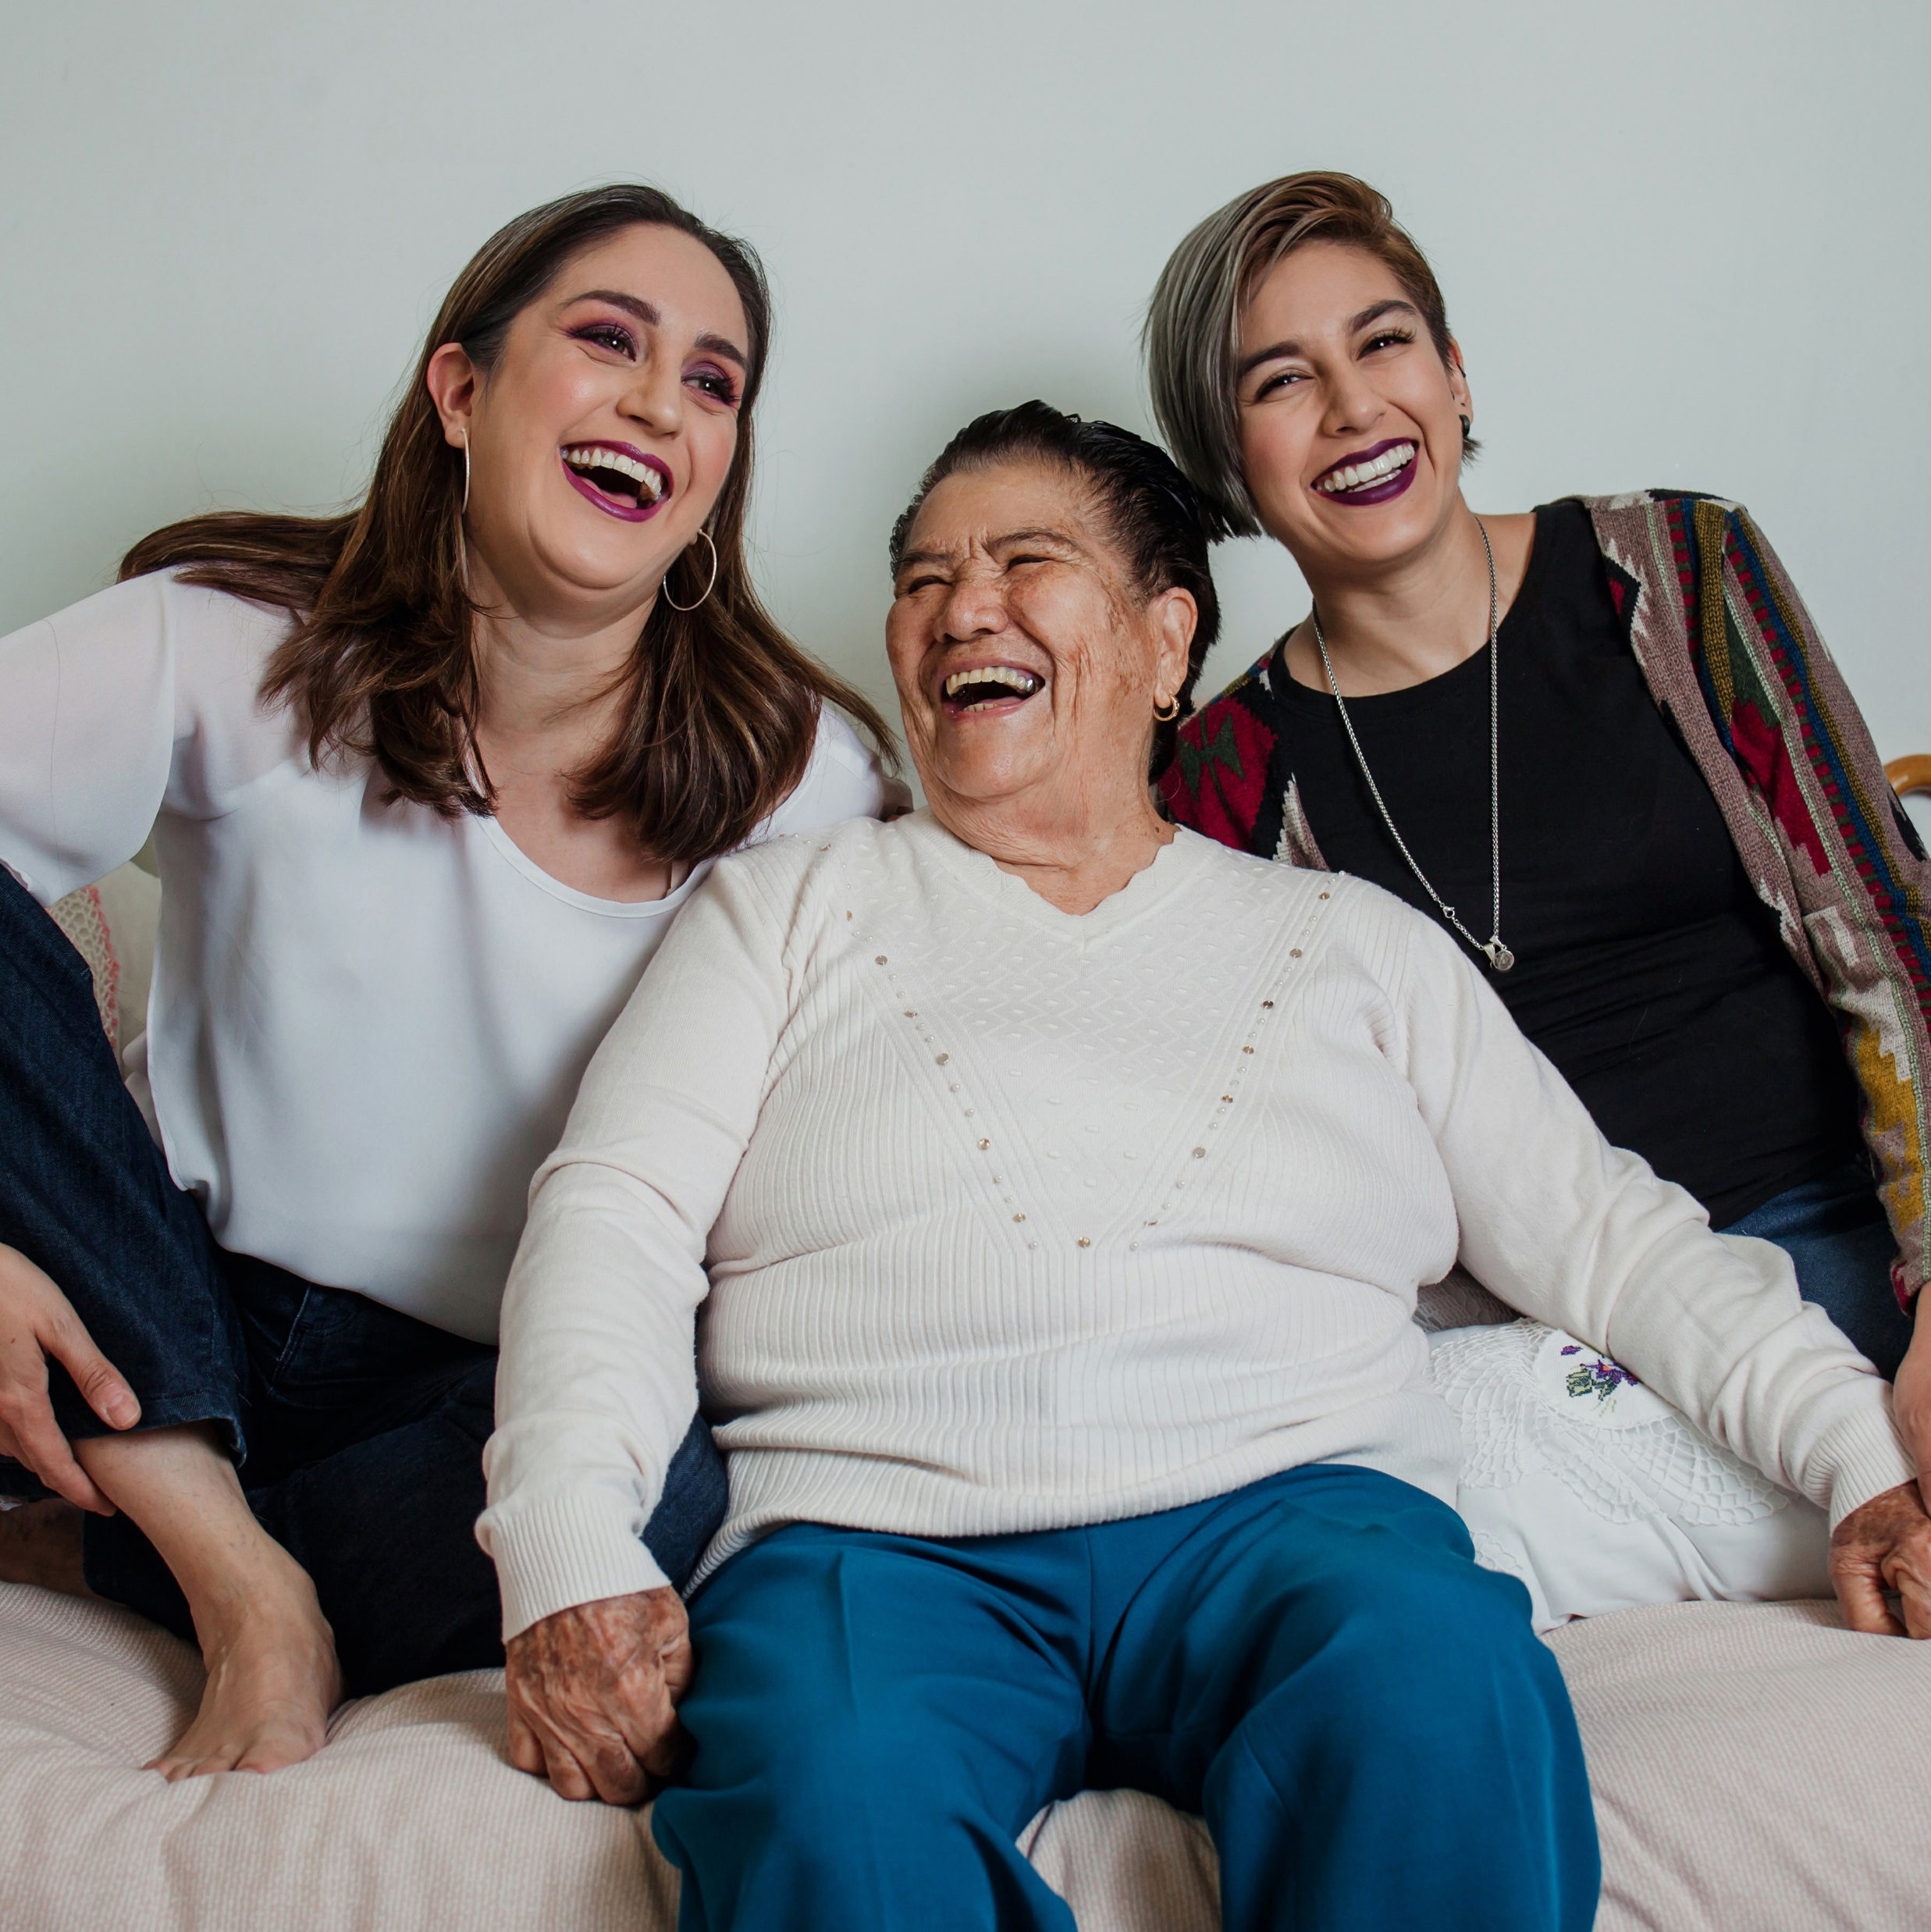
MOC 4: Quality Measurement & Performance Improvement

Slide 30

CY 2026 MODEL OF CARE TRAINING
Quality Improvement Requirements
SNP conducts a QI program that measures effectiveness of MOC
Goal is to improve the SNP’s ability to deliver high-quality services and benefits
Leadership, managers and governing body evaluates performance, identifies improvement opportunities to modify systems and processes

Slide 31
CY 2026 MODEL OF CARE TRAINING
MOC Quality Performance Improvement Plan
SNP QI plan that delivers appropriate services to enrollees, based on their needs
SNP collects and analyzes data and performance to evaluate and report MOC quality
Leadership, management, SNP personnel and other stakeholders are involved with internal quality process
SNP-specific measurable goals and outcomes are established; SNP determines goals met/not met

Slide 32
CY 2026 MODEL OF CARE TRAINING
Measurable Goals and Health Outcomes
Establish Measurable goals to improve
affordability
Identify specific health outcomes measures
population health outcomes
Establishing methods to assess and track MOC's impact on health outcomes
access
Plan level
Process to determine if health outcome goals are met/not met
Devise steps to be taken if goals are not met in the expected time frame

Slide 33
CY 2026 MODEL OF CARE TRAINING
Measuring Patient Experience of Care (Satisfaction)
Select a Survey Tool
Explain rationale for selection of survey tool
Integrate survey results into overall MOC performance plan
Take steps to address issues identified in survey responses

Slide 34
CY 2026 MODEL OF CARE TRAINING
Ongoing Performance Improvement Evaluation of the MOC
Continuous monitoring and evaluation of performance
Use indicator results and measures to support ongoing improvement
Use the results to continually assess and evaluate quality
Timely interpretation and response to lessons learned through MOC evaluation
Document and communicate evaluation to key stakeholders

Slide 35
CY 2026 MODEL OF CARE TRAINING
Dissemination of SNP Quality Performance Related to the MOC
Performance results and other pertinent information is shared with stakeholders
Establish the schedule of frequency of communications with stakeholders
Establish methods for ad hoc communications with stakeholders
Identify accountable person(s) for communicating timely performance updates

Slide 36
CY 2026 MODEL OF CARE TRAINING
Congratulations!
You have completed the Model of Care Training
Next Steps
Third party entities must track completion of annual Model of Care training
Please follow the organization’s guidance to ensure accurate training records are maintained

