Slide 1

Pediatric Vision Screening

Slide 2



County Collaboration
"This presentation has been developed in collaboration with the health plans listed to the right, reflecting the collective efforts and contributions of all parties involved."

Slide 3
Learning Objectives
Required for any provider/staff performing screenings or teaching others
Understand the importance of vision screening during childhood.
Become aware of eye problems that affect vision.
Identify the steps of Visual Acuity (VA) screening and document results.
Who needs to be trained: All providers and staff involved in screenings, as well as those
responsible for training others.
Frequency: The training is required for all new hires and must be repeated every 4 years
thereafter.
Notes:
Read Objectives

Slide 4

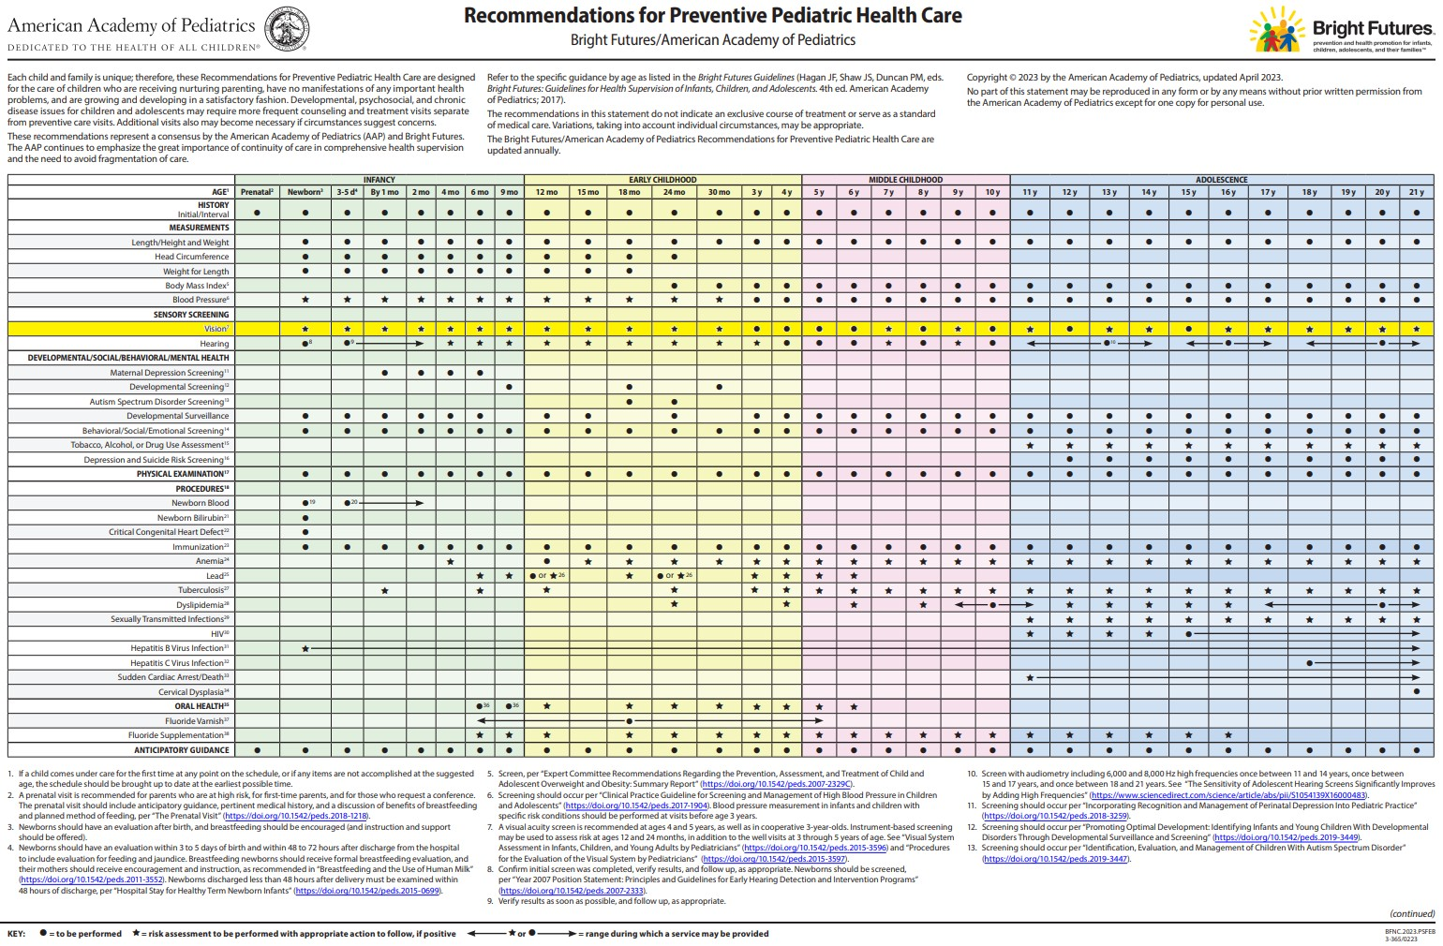
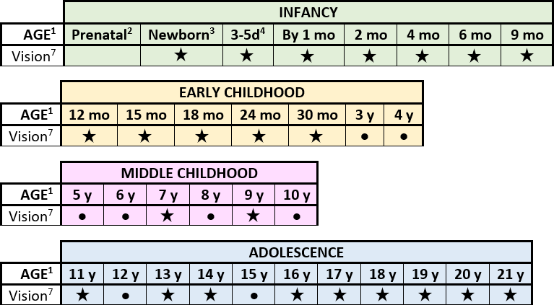


Why Perform Vision Screening?
Recommended as part of Bright Futures/American Academy of Pediatrics (AAP) Periodicity Schedule for Preventative Pediatric Health Care.
● = to be performed
= risk assessment to be performed with appropriate action to follow, if positive
● = range during which a service may be provided
Notes:
Recommended part of Bright futures
. The dot means a screening test is to be performed, the star means risk assessment is to be performed with appropriate action to follow,

Slide 5
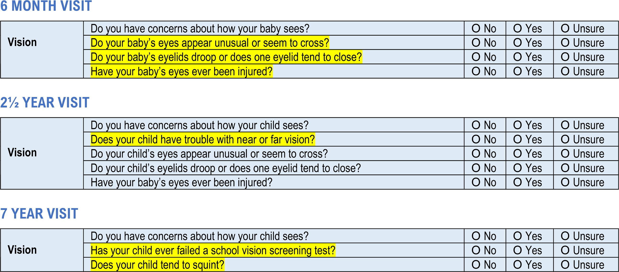
Why Perform Vision Screening?
For ages where risk assessment is required, see Bright Futures Tool and Resource Kit, 2nd Edition.
Bright Futures Pre-visit Questionnaire (available in all ages)
Notes:
Here is an example of a risk assessment at different age grouping found in bright futures tool kit

Slide 6
Why Perform Vision Screening?
Primary Care Clinicians and the medical staffs are first line of defense to detect refractive error in children.
Goal: Early detection of refractive error
Prevent Amblyopia – “lazy eye”
Allow for more normal vision development
May decrease impact of:
Learning problems
Poor school performance
Developmental delays
Behavior concerns
Notes:
Read slide

Slide 7
ABC Signs of Possible Vision Problems
Assess and observe for signs of possible vision problems
Appearance | Behavior | Complaints
Eye(s): Don’t line up, don’t look straight Watery or red Jerks side to side Iris: Irregular size or shape Pupil: Irregular size or white reflection in color photograph Eyelid(s): Red, crusted, swollen, not fully open (droopy or bump) | Eye(s): Rubs, squint, blink often Close/cover one eye Tilt head or turns face Bring objects closer Difficulty concentrating, cranky, or avoid doing close-up work Clumsy | Eye(s): Itch, burn, or scratchy When looking at near objects: Blurred vision, dizzy, headaches, or nausea Light is too bright Can’t see what other people can see Worser vision at end of the day Difficulty copying materials from the front of the room (whiteboard/chalk board, projector/monitor)
Notes:
Read slide

Slide 8




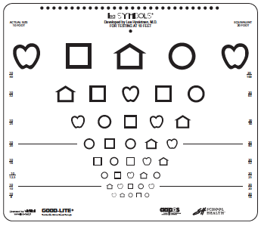
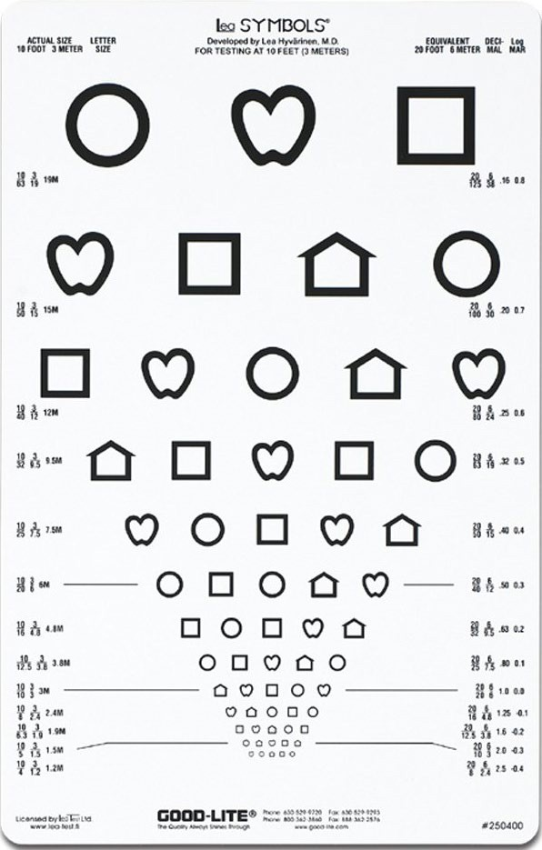
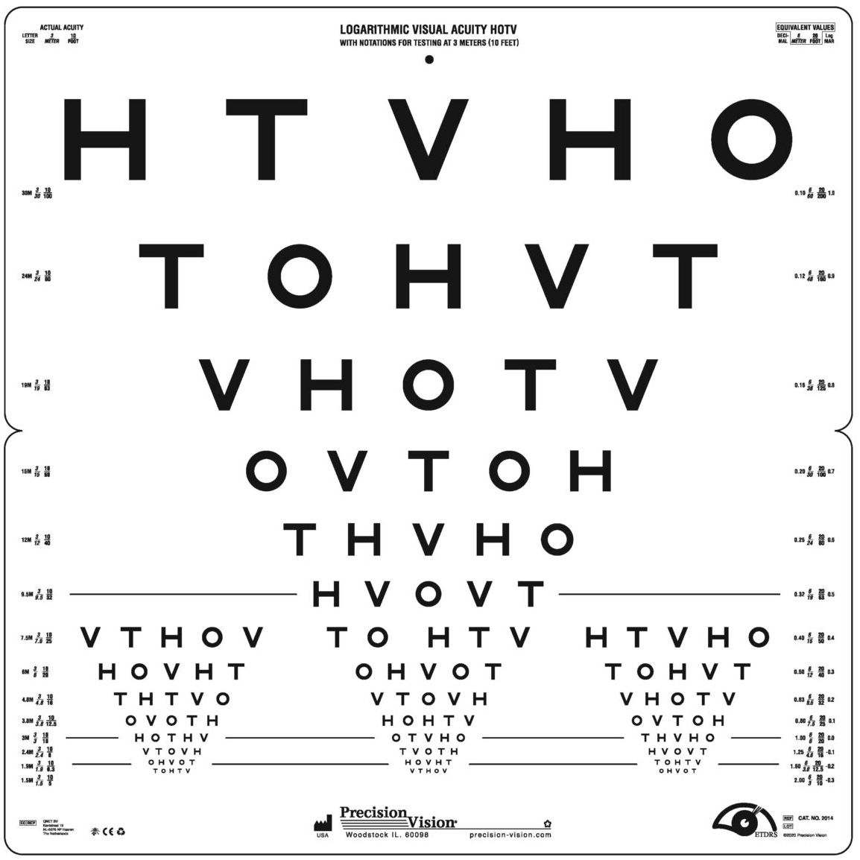
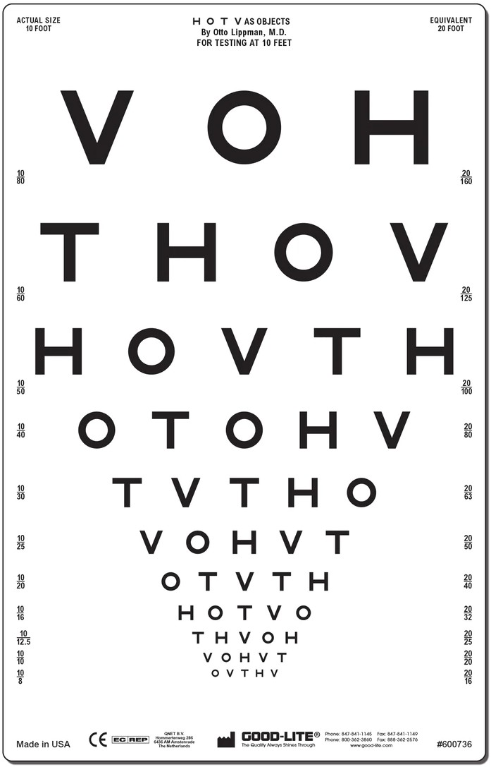

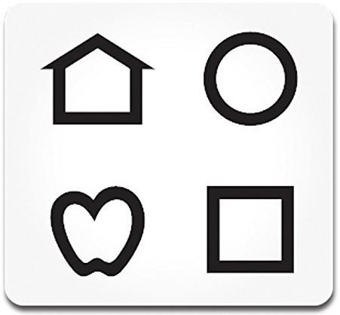
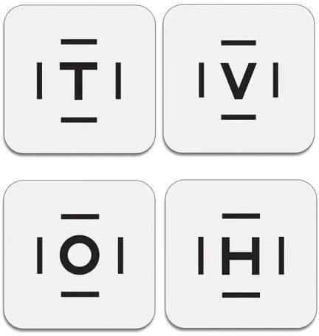
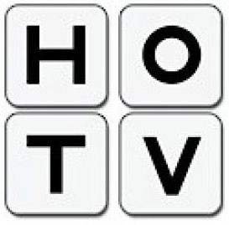
Recommended Chart Types: Ages 3 to under 6 Years
LEA SYMBOLS HOTV LETTERS
Response panel
Response cards
Notes:
Here are some examples of recommended eye charts

Slide 9




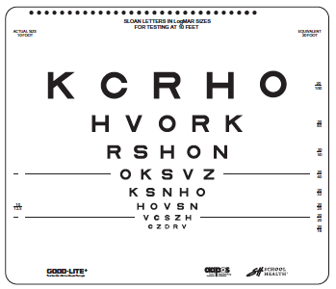
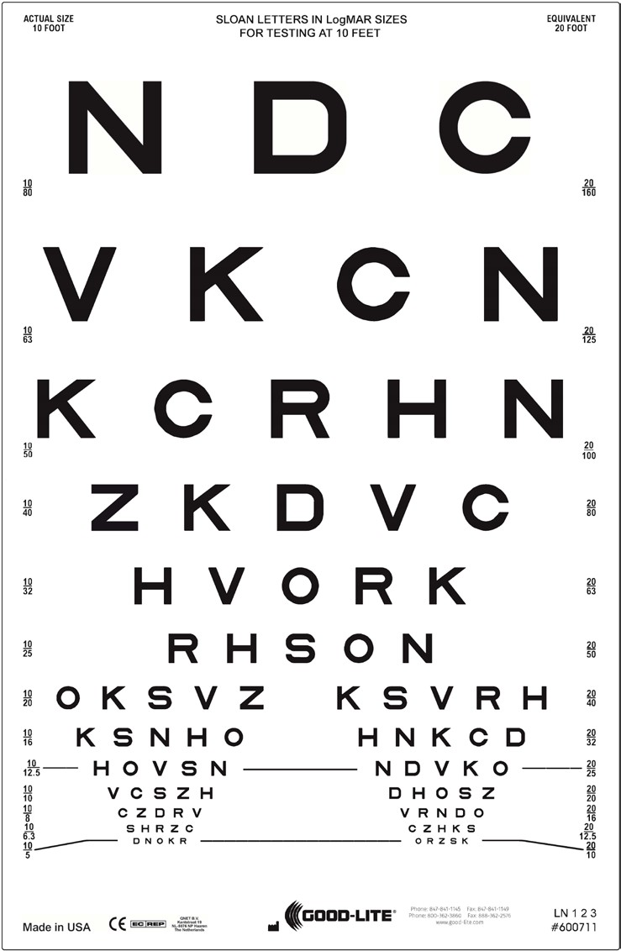
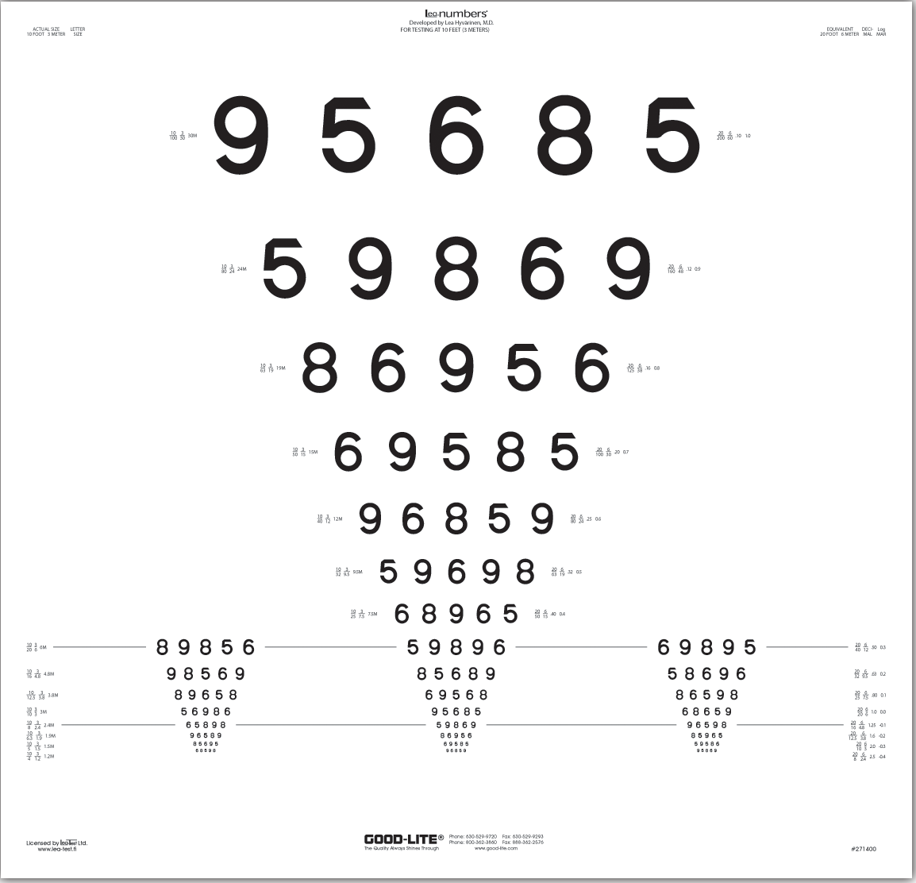
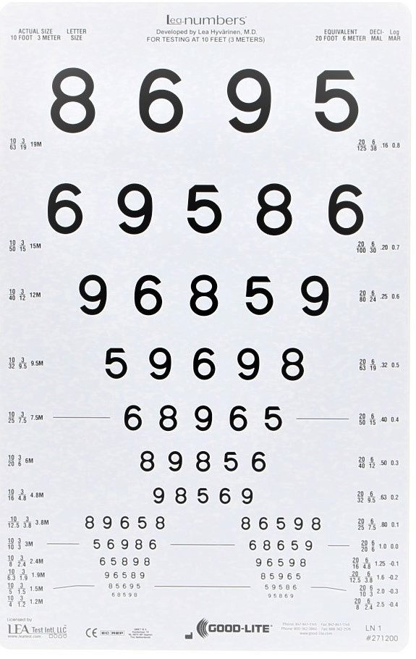


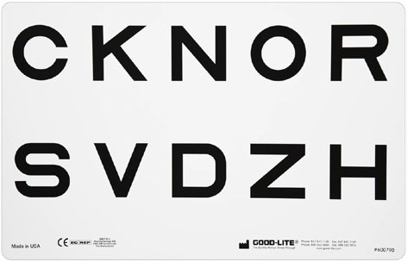
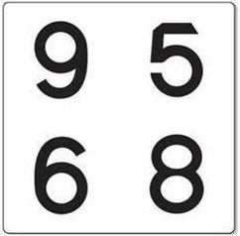
Recommended Chart Types: 6 Years and Older
SLOAN LETTER (PREFERRED) LEA NUMBERS
Response panel
Response panel
Notes:
Here are some examples of recommended eye charts

Slide 10





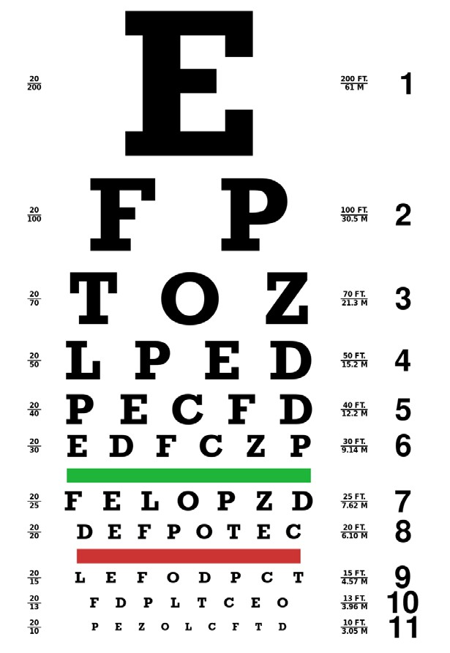
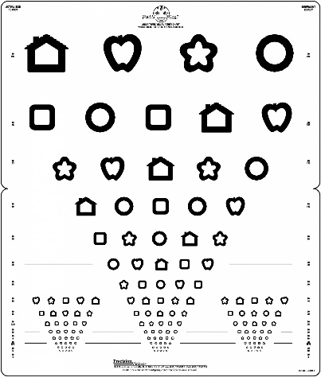
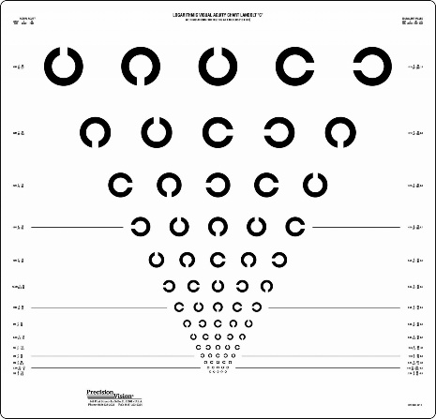

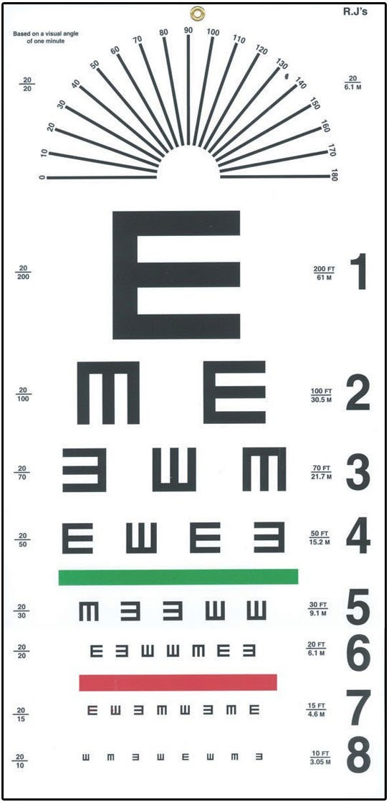


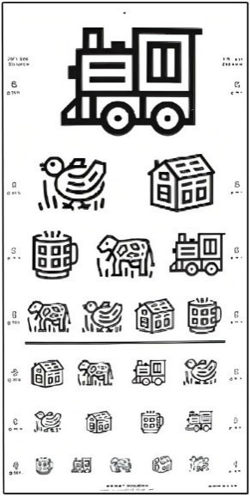
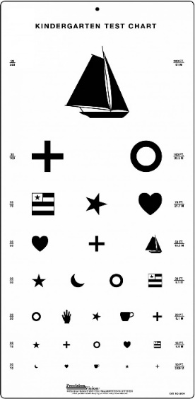

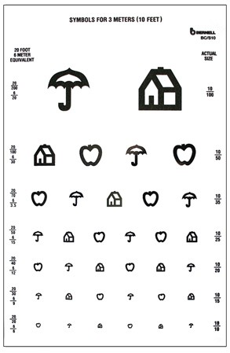

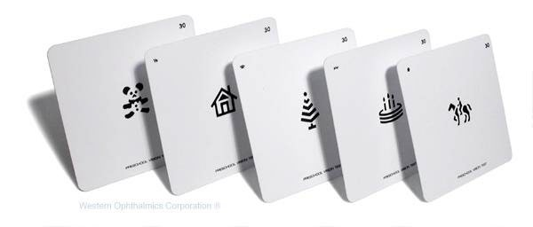
Vision Screening Charts NOT Recommended
Snellen Patti Pics Landolt C Blackbird Tumbling E
\
Kindergarten “Sailboat”
Wrights Figures
Lighthouse “House Apple Umbrella”
Allen Preschool Cards
Notes:
Snellen can still be used - if SLOAN not available in clinic, but it is imperative to (educate site to get SLOAN)

Slide 11


Understanding the Eye Chart
Chart type and distance the chart should be used (10 feet).
Located at top, bottom or front page on flipbooks
Critical Line: The age-dependent VA measurement that the child is expected to see normally and pass.
▪
▪
Different for younger and older children. May or may not be marked.
ACUTAL SIZE
10 FOOT
EQUIVALENT 20 FOOT
▪
Visual Acuity Measurement: XX/XX
10/50
10/32
20/100
20/63
Top #: Vision distance the person being screened can see in comparison to.
Bottom #: Vision distance a person with normal vision can see.
Higher this number, the worse the eyesight of the person being screened.
20-Foot Equivalent:
10/25
20/50
10/20
20/40
10/16
20/32
10/12.5
20/25
10/10
20/20
10/8
20/16
20/XX: is the equivalent VA measurement to a person being screened at a vision distance of 20 feet (the number to document).
10/XX is the actual screening distance for a 10-foot chart.
Notes:
Read slide then add note
Note: when determining what is ‘eye level’……… height can vary between patients, will require Velcro to adjust

Slide 12
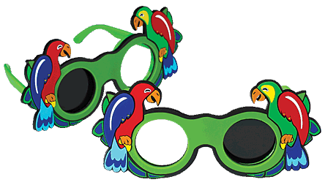
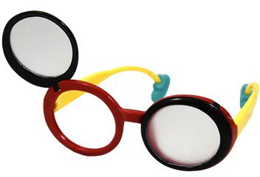

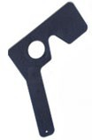
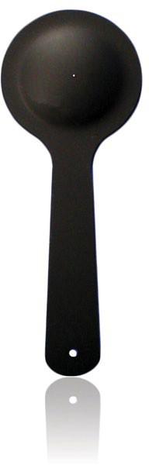
Occluders
Completely cover non-tested eye to prevent peeking.
Acceptable | NOT Recommended
Occlusion glasses Mask occluders Paddle occluders | Hand Paper cup Tissue paper
Age 10 years and older
Notes:
Read slide

Slide 13
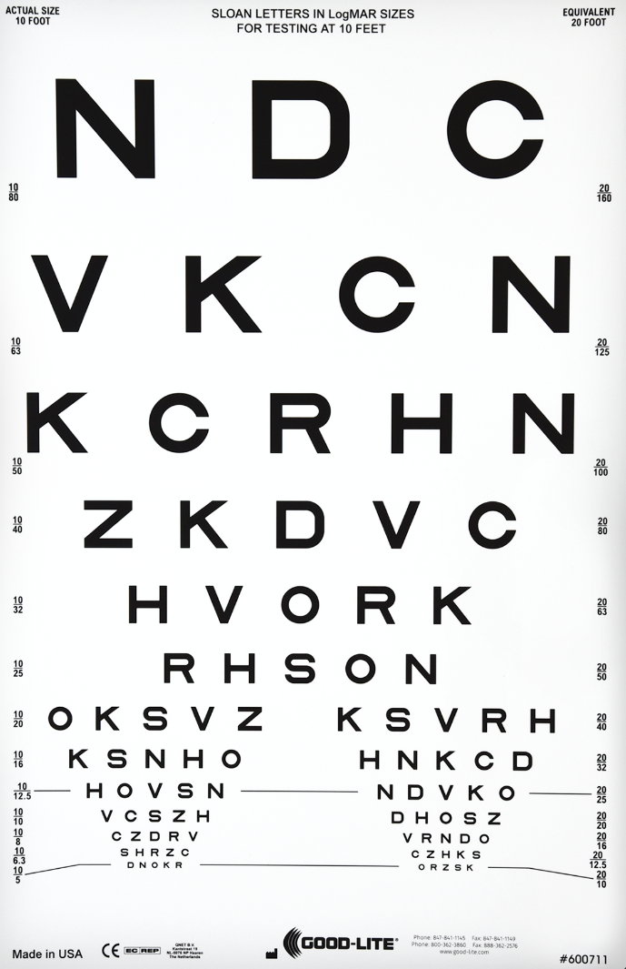
VA Screening Method: Threshold Screening
Left Eye Screening
(cover right eye)
Right Eye Screening
(cover left eye)
Have child identify the first optotype of each line starting from the top line and moving down until an optotype is missed
Right Eye- first optotype on the right side
Left Eye- first optotype on the left side
2. Screen the line above the missed optotype
If they pass this line, move down until the fail
If they fail this line, move up until they pass
PASS: 3 or more optotypes correct
FAIL: missing 3 or more optotypes
3. Always record the pass line using the 20-foot equivalent for each eye
X
X
OD 20/50
3. PASS, stop
1. PASS, move down
X
X
X
X
X
2. FAIL, move up
X
X
X
2. FAIL, stop
X
X
X
X
1. FAIL, move up
OS 20/40
X
Notes:
Don’t forget animation!!
Screen Right eye first (cover the left eye).
Read the first optotype on the right side and move down until an optotype is missed. (use action buttons to show the optotypes C, N, N, C, K, N, H, D, and here they fail and then you stop)
Return to the line above the missed optotype or the 20/32 line and have the child identify each optotype on line from left to right.
Start at this line and they miss the H, N, K and they get C and D correct. If they miss 3 or more optotypes, they read the line above. Keep repeating until they can identify 3 or more optotypes and record the Visual Acuity measurement. The child failed this line since the child missed 3 out of 5 so we move up.
Now the child get’s K right, then miss S, miss V, and miss R, and get H right. The child still fails, since they missed 3.
We read the line above from left to right and here the child only misses S and O. The child passes since they got 3 correct so we can stop.
Record the Visual Acuity for that line at the 20 foot equivalent, so OD for Right Eye and 20/50
If a child correctly identifies 3 optotypes on the line above the missed optotype, the child moves down a line until they miss 3 or more optotypes. Record the VA measurement of the passing line (3 or more optotypes correct). We will now demonstrate this with the left eye.
Screen Left eye (cover the right eye)
Read the first optotype on the left hand side and move down until an optotype is missed.
Return to the line above or line 20/40 and have child read the line from left to right.
Here they read it and miss 2 out of 5. So instead of moving up, we move down since they passed this line.
Now we read this line and they miss K again. They got S correct and they miss N and H. Here they missed 3 optotypes, which means they failed this line.
You will be recording the pass line. Always record the pass line at the 20 foot equivalent. This would be OS for Left Eye and 20/40.

Slide 14
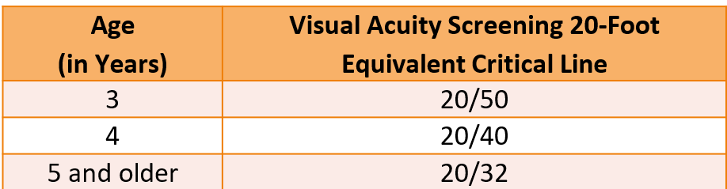
VA Screening Method: Critical Line Screening
Have child identify the top line of large optotypes with both eyes uncovered, reading from left to right
Cover one of the crowded box and have the child identify the optotypes in the other crowded box, reading from left to right
Right eye screening: read optotypes in the top crowded box
Left eye screening: read optotypes in the bottom crowded box
PASS: 3 or more optotypes correct
FAIL: missing 3 or more optotypes
3. Note you can use a threshold chart to do the Critical Line Screening method as long as the critical line measurement for the child is split into two on the eye chart and there is no need to cover any lines during the screening. The displayed eye chart splits in two at 20/40.
OD 20/32 PASS
20/32
Right Eye Screening (cover left eye & bottom box)
X
X
20/32
Left Eye Screening (cover right eye & top box)
X
X
X
OS 20/32 Fail
Notes:
Don’t forget animation!!!
The critical line eye chart is a much faster method, but cannot identify 2-line difference between the eyes. The critical line is the age dependent Visual Acuity measurement that the child is expected to see normally and pass.
Have the child read the top line with both eyes uncovered, reading from left to right to familiarize them with reading the eye chart. (can also use reading right to left to not get false positive if they have memorized the line)
For right eye screening, have child cover the left eye and you will cover the bottom box with either your hand or a piece of paper. Here they miss two. You will record OD 20/32 since that’s the measurement acuity and this is a Pass
Now we will screen the left eye. Have the child cover the right eye, and you will cover the top box with either your hand or piece of paper. Here they miss three. You will record OS 20/32 Fail.
Read left hand side.

Slide 15
Age-Dependent Pass/Fail Guidelines (Referral Criteria)
Critical Line: The VA measurement the child is expected to see normally and pass for that age.
Must correctly identify majority of the optotype on the line (e.g. ≥3 out of 5).
Age (in Years) | Visual Acuity Screening 20-Foot Equivalent Critical Line
3 | 20/50
4 | 20/40
5 and older | 20/32
Refer:
If child fails to identify majority of the optotype on the critical line with either eye
(e.g. ≤2 out of 5).
If there is a two-line or more difference between the eyes, even if both eyes are within the passing range (e.g. 20/20 and 20/32).
Notes:
Read Slide

Slide 16
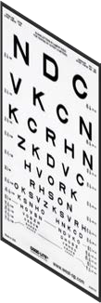
Key Points
SCREENING LINE
Screening line marked at 10 feet on the floor.
Screening line is directly in front of eye chart.
May use arch or heel line
Eye chart should be at child’s eye level and screen each eye separately
Vision screening area
Out of traffic area
Have adequate lighting
10 FEET
SCREENING LINE
Notes:
Screening can be done with a 10 foot chart (or 20 foot if using Snellen chart), the line on the floor needs to correlate with appropriate chart and vision screening area should be out of traffic area with adequate lighting. Screening is mid-line to the chart and child should stand with arch of each foot on the line.

Slide 17
Untestable Children
If child is unable to cooperate during the screening, make a second attempt the same day (i.e. later during the same visit). If same day rescreening is not possible, reschedule as soon as possible, but no later than 6 months.
Schedule follow up appointment prior to the patient leaving provider office.
If you cannot screen a child, then refer to an ophthalmologist or optometrist experienced in the care of children for an eye examination.
Notes:
For uncooperative children, make a second attempt later in the visit. If that is not possible, reschedule no later than 6 months. If child can not be screened, refer to an ophthalmologist or optometrist.

Slide 18
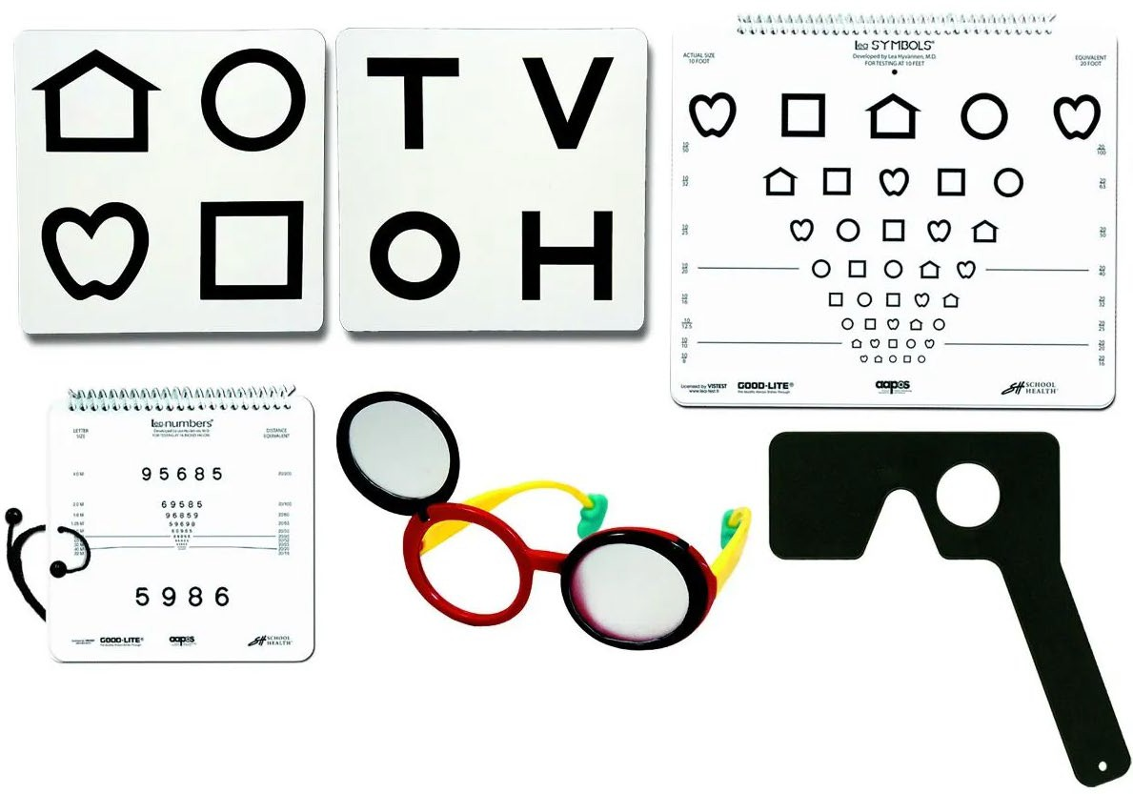
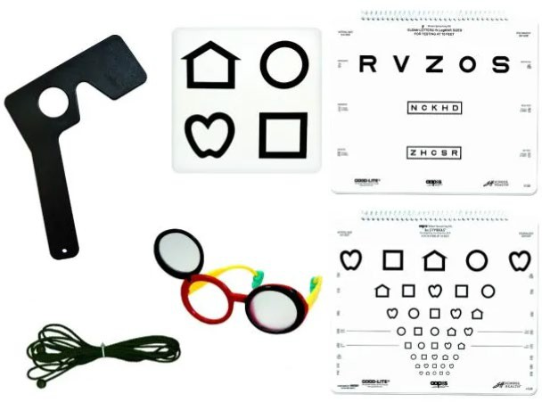
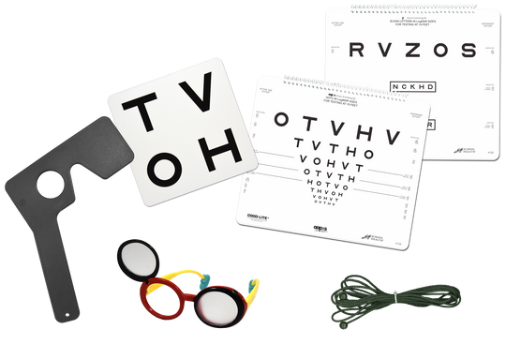
AAPOS Vision Screening Kits
NEAR & DISTANCE: THRESHOLD FORMAT
4 Distance Eye Charts (10-Foot) LEA Symbols
LEA Numbers
HOTV Letters
Sloan Letters
Matching response panels
LEA Symbols
HOTV Letters
Occluders:
Frosted/blackout flip-up occluder glasses
Lorgnette spectacle occluder “Mardi Gras Mask occluder”
DISTANCE: THRESHOLD & CRITICAL LINE FORMAT
6 Distance Eye Charts (10-Foot):
LEA Symbols OR HOTV Letters
Sloan Letters
Matching response panel
LEA Symbols OR HOTV Letters
Occluders:
Frosted/blackout flip-up occluder glasses
Lorgnette spectacle occluder “Mardi Gras Mask occluder”
LEA Symbols/Sloan OR HOTV/Sloan
Notes:
There are vision screening kits available. Here are some examples.

Slide 19
What is the Difference Between Vision Screening with Eye Charts and Vision Screening with Devices?
Vision screening with eye charts measure the actual visual acuity (e.g. 20/20).
Vision screening devices DO NOT measure visual acuity directly.
– Screening instruments test for eye conditions or risk factors that are known to cause decreased vision or amblyopia.
Notes:
The main difference between eye charts and screening devices is that devices does not measure visual acuity but can detect risk factors.

Slide 20
Instrument-Based Vision Screening
The process of using an automated instrument (photoscreener, autorefractor or other device) to screen for risk factors for vision problems.
Does not replace visual acuity screening with eye charts.
Endorsed by American Academy of Pediatrics (AAP).
Useful for:
Children 1 year to under 3 years of age
Usually unable to perform visual acuity screening
Some children ages 3-5 years
Acuity chart screening is preferred, but…
Instrument-based screening is an acceptable alternative.
Older children who are non-verbal, developmentally delayed or otherwise unable to perform VA screening with eye charts.
Notes:
Instrument based screening is endorsed by the AAP and includes instruments such as photoscreener, autorefractor that does not replace screening with eye charts.

Slide 21
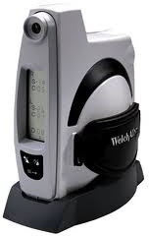
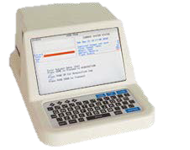
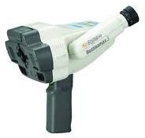
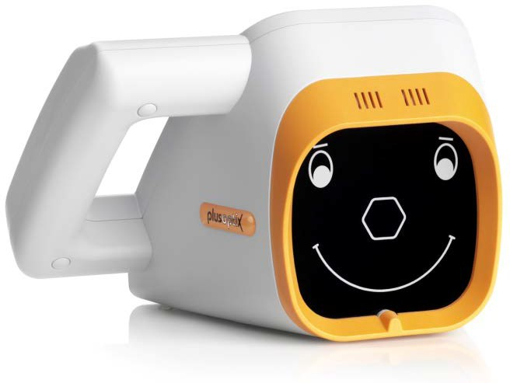
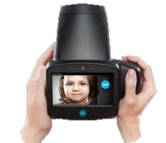
Common Vision Screening Instruments
Righton Retinomax
iScreen
Welch Allyn SureSight
PlusOptix S12R
Welch Allyn “Spot”
Notes:
Here are examples of common screening instruments. All results must be documented in patient’s medical records.

Slide 22
American Academy of Pediatrics (AAP) Policy Statement
Visual System Assessment in Infants, Children and Young Adults by Pediatricians
Pediatrics, January 2016
Screening with a tool such as a photoscreener is recommended for children 12 months of age and older unless they can reliably perform visual acuity screening with eye charts.
Visual Acuity (VA) is the quantifiable measure of the ability to identity black symbols on a white background at a standardized test distance.
VA screening using eye charts remains the gold standard. It can begin as early as 3 years of age.
https://publications.aap.org/pediatrics/article/137/1/e20153597/52806/Procedures-for-the-Evaluation-of-the-Visual-System
Notes:
Read slide

Slide 23
Common Refractive Errors in Children

Slide 24












Eye Anatomy
Sclera Iris
Sclera
Pupil
Cornea
Iris
Optic Nerve
Pupil
Lens
Retina
Muscles
Notes:
Here is the basic anatomy of the Eye.

Slide 25
Amblyopia
Amblyopia is the leading cause of vision loss among children.
Impairment of vision development at a brain level.
Eye(s) and brain is not working together.
One eye sees a blurred view and the other eye sees a clearer view. The brain only processes the image from the clearer view eye.
Notes:
Read slide

Slide 26

Amblyopia
Amblyopia can only develop during childhood.
If not treated in childhood, amblyopia may result in permanent vision loss.
The most common cause of vision loss in adults 20-70 years of age is untreated childhood amblyopia.
Blurred View
Normal View
Notes:
Read slide

Slide 27
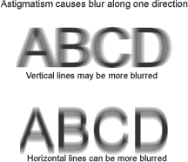

Common Causes of Amblyopia
1. Types of refractive errors
c. Astigmatism: an irregular curve in
the eye causing blurry vision at all
distances
Notes:
Common Causes of Amblyopia include (read the slide)

Slide 28
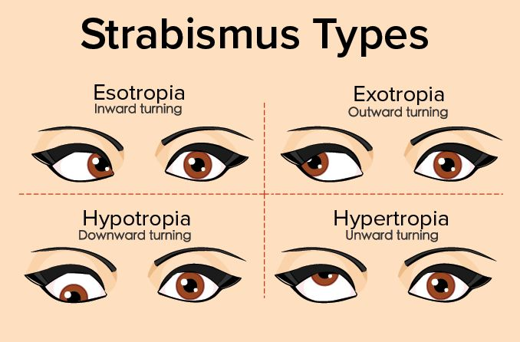
Amblyopia: Common Causes
Strabismus “crossed eyes”: misalignment of the
eyes
May have double vision
One or both eyes turning inward
One or both eyes turning outward
One eye turning up or down
Notes:
Read slide

Slide 29

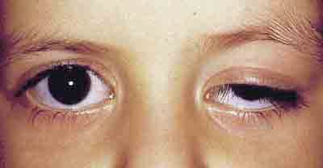
Common Causes of Amblyopia
3. Obstruction
a. Ptosis: drooping of an eyelid due to a weak lid muscle.
May obstruct vision
Look for chin elevation in these children.
Notes:
Read the slide

Slide 30
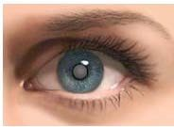
Common Causes of Amblyopia
3. Obstruction
b. Cataract: condition in which the lens of the eye becomes progressively cloudy, resulting in blurred vision.
Notes:
Read the slide

Slide 31
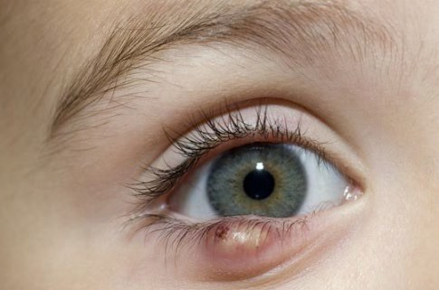
Common Causes of Amblyopia
3. Cyst
c. swelling/lump caused by liquid, semisolid, or gaseous filled capsule
Notes:
Read the slide

Slide 32
Amblyopia: Treatment
Correcting the refractive errors (glasses and/or contact lenses)
Forcing child to use the weaker eye (eye patch or eye drops to blur the better eye)
Removing the obstruction (surgery)
Goal: to improve vision, enabling child to see as clearly as possible.
Notes:
Read Slide

Slide 33
Screening Early is Best
National Eye Institute (NEI)
Amblyopia affects 2-3% of children in the United States.
About 4.5 million children with preventable vision loss.
School-aged vision screening may be too late.
Amblyopia is harder to treat after 5 years of age.
By 7 years of age, some vision loss from amblyopia may become permanent.
https://www.uspreventiveservicestaskforce.org/Page/Document/evidence-summary/vision-in-children-ages-6-months-to-5-years-screening
Notes:
Read slide

Slide 34
Newborn to 35 Months (0-3 Years)
Procedures for the Evaluation of the Visual System by Pediatricians
Pediatrics, January 2016
Ask health history of child and immediate family history of eye problems.
Check vision (tracking), eye movement (motility) and alignment (strabismus)
PERRLA: Pupil are Equal, Round, Reactive to Light, and Accommodating
Corneal Light Reflex
Retinal Red Reflex
Note: This assessment can also be done on older children of any age with developmental delays.
Notes:
Read slide

Slide 35

36 to 47 Months (3 Years)
LEA Symbols or HOTV Letters
Must be able to identify the majority of the optotypes at the 20-foot equivalent VA measurement of 20/50 with each eye.
Screening distance:
10 feet using a 10-foot chart
Fully cover opposite eye.
20/50
Notes:
Read slide

Slide 36

48 to 59 Months (4 Years)
LEA Symbols or HOTV Letters
Must be able to identify the majority of the optotypes at the 20-foot equivalent VA measurement of 20/40 with each eye.
Screening distance:
10 feet using a 10-foot chart (recommended)
Fully cover opposite eye.
20/40
Notes:
Read slide

Slide 37

60 to 71 Months (5 Years)
LEA Symbols or HOTV Letters
Must be able to identify the majority of the optotypes at the 20-foot equivalent VA measurement of 20/32 with each eye.
Screening distance:
10 feet using a 10-foot chart (recommended)
Fully cover opposite eye.
20/32
Notes:
Read slide

Slide 38

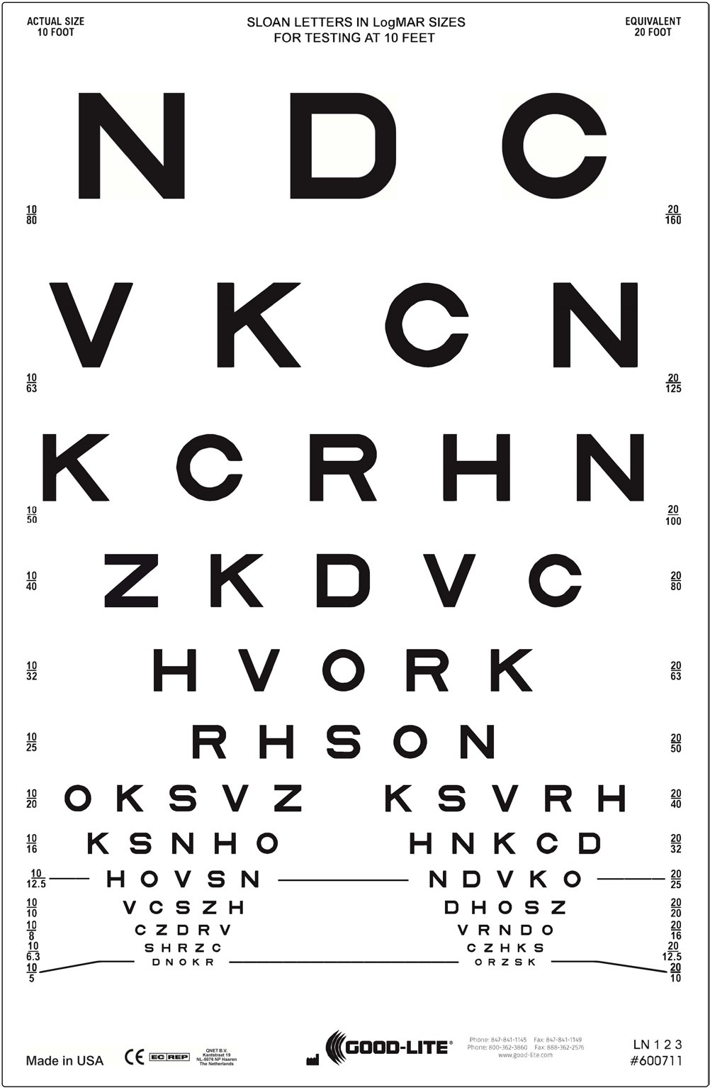
72 Months and Older (6+ Years)
Sloan Letters or LEA Numbers
Sloan letters chart is preferred
Use LEA symbols or HOTV letters for children who do not know their letters.
Must be able to identify the majority of the optotypes at the 20-foot equivalent VA measurement of 20/32 with each eye
Screening distance is 10 feet using a 10-foot chart(recommended)
Fully cover opposite eye.
Repeat screening every 1-2 years.
Risk assessment should be done when screening is not required.
20/32
Notes:
Read slide

Slide 39
Automatic Referral for Eye Exam
Children with the following disorders should bypass screening and should be referred directly to an eye specialist:
Recognized eye disorders (e.g. strabismus, ptosis)
Known neurodevelopmental disorders:
Hearing impairment
Motor abnormalities (e.g. cerebral palsy)
Down Syndrome
Cognitive impairment
Autism spectrum disorder
Speech delay
Notes:
Read slide

Slide 40
Automatic Referral for Eye Exam
Systemic diseases present (e.g. diabetes, sickle cell disease, hypertension)
Taking medications known to cause eye disorders (e.g. some anti-depressants and steroids)
First-degree relative with strabismus or amblyopia
Prematurity: less than 32 weeks of gestation
Parent believes child has vision problem
Notes:
Automatic referral for eye exam should be done for systemic diseases, patients taking medications known to cause eye disorders, first–degree relative with strabismus or amblyopia, prematurity, or when parent believes child has a vision problem.

Slide 41
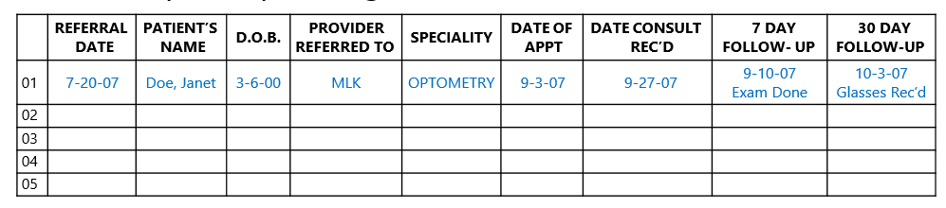
Follow-Up
Maintain referral log to track status of referral.
Follow-up with parent/guardian as needed.
42
Notes:
It’s important to maintain a referral log for tracking and follow-up purposes.

Slide 42
Acknowledgments
These guidelines are based on recommendations from the American Academy of Pediatrics (AAP) and the National Expert Panel of the National Center for Children’s Vision and Eye Health (NCCVEH) at Prevent Blindness.
These slides have been adapted from the American Association for Pediatric Ophthalmology and Strabismus (AAPOS) with their permission.
Notes:
Read slide

Slide 43
References and Links
Bright Futures/AAP Periodicity Schedule for Preventative Pediatric Health Care
Bright Futures Tool and Resource Kit, 2nd Edition
Visual System Assessment in Infants, Children and Young Adults by Pediatricians
American Academy of Pediatrics Policy Statement
Pediatrics. January 2016. Volume 137. Issue 1
Procedures for the Evaluation of the Visual System by Pediatricians
American Academy of Pediatrics Clinical Report
Pediatrics. January 2016. Volume 137. Issue 1
Vision Screening for Children 36 to <72 Months: Recommended Practices
American Academy of Optometry
Optometry and Vision Science. January 2015. Volume 92. No. 1
Bright Future and Preventative Medicine Coding Fact Sheet
American Academy of Pediatrics
AAP.org → Practice Management → Coding and Valuation → Coding Fact Sheet → Bright Future and Preventative Medicine
Updated January 2021
A Guide for Vision Screening in California Public Schools
California Department of Education. April 2019
CHDP Health Assessment Guideline (HAG) #27 Vision Screening
Notes:
Here are links for additional resources

Slide 44
Post Test and Practice

Slide 45
Post-Test
Visual acuity screening starts at what age?
At birth
2 years
3 years
5 years
Which of the following are NOT requirements for conducting visual acuity screening?
A well-lit room
Absence of visual and auditory distractions
Eye chart should be at child’s eye level
An ophthalmologist
Eyes should be screened binocularly (both eyes together).
True
False
The “Critical line” is
The top line of the wall chart
The red line on the flipchart or wall chart
The age-dependent Visual Acuity (VA) measurement that a child is expected to see normally and pass
None of the above
Notes:
Ask how long to pause on each post test slide? Then click for animation and how do we keep it bolded, or animation completed?
Thank you for attending this presentation. Now let's put your knowledge into action. See how much you learned during this training. Please answer the questions on the post test slides and then the answers will be revealed.

Slide 46
Post-Test
The “Threshold line” is
The top line of the wall chart
The smallest Visual Acuity (VA) measurement that a child can pass
The age-dependent Visual Acuity (VA) measurement that a child is expected to see normally and pass
None of the above
What is the screening distance for children ages 3-5 years?
15 feet
10 feet
20 feet
What is the screening distance for children 6 years and older?
15 feet
10 feet
20 feet
Besides adhesive patches, what material is recommended for occlusion of the eye?
Child’s hand
Occluder/glasses
Tissue
Paper cup
Notes:
Narrator read the question……pause…….. Then circle the answer

Slide 47
Post-Test
Instrument-based vision screening measures visual acuity.
True
False
What is the referral criteria for Visual Acuity Screening for 3-year-olds?
Failure to correctly identify the majority of the optotypes at the 20-foot equivalent VA measurement of 20/50, or worse, in either eye.
Failure to correctly identify the majority of the optotypes at the 20-foot equivalent VA measurement of 20/40, or worse, in either eye.
Failure to correctly identify the majority of the optotypes at the 20-foot equivalent VA measurement of 20/32, or worse, in either eye.
None of the above
What is the referral criteria for Visual Acuity Screening for 4-year-olds?
Failure to correctly identify the majority of the optotypes at the 20-foot equivalent VA measurement of 20/50, or worse, in either eye.
Failure to correctly identify the majority of the optotypes at the 20-foot equivalent VA measurement of 20/40, or worse, in either eye.
Failure to correctly identify the majority of the optotypes at the 20-foot equivalent VA measurement of 20/32, or worse, in either eye.
None of the above
Notes:
Narrator read the question……pause…….. Then circle the answer

Slide 48
Post-Test
What is the referral criteria for Visual Acuity Screening for children 5 years and older?
Failure to correctly identify the majority of the optotypes at the 20-foot equivalent VA measurement of 20/50, or worse, in either eye.
Failure to correctly identify the majority of the optotypes at the 20-foot equivalent VA measurement of 20/40, or worse, in either eye.
Failure to correctly identify the majority of the optotypes at the 20-foot equivalent VA measurement of 20/32, or worse, in either eye.
None of the above
How soon can a second attempt be made to screen an uncooperative child?
The same day
Later during the same visit
No later than 6 months
None of the above
Notes:
Narrator read the question……pause…….. Then circle the answer

Slide 49

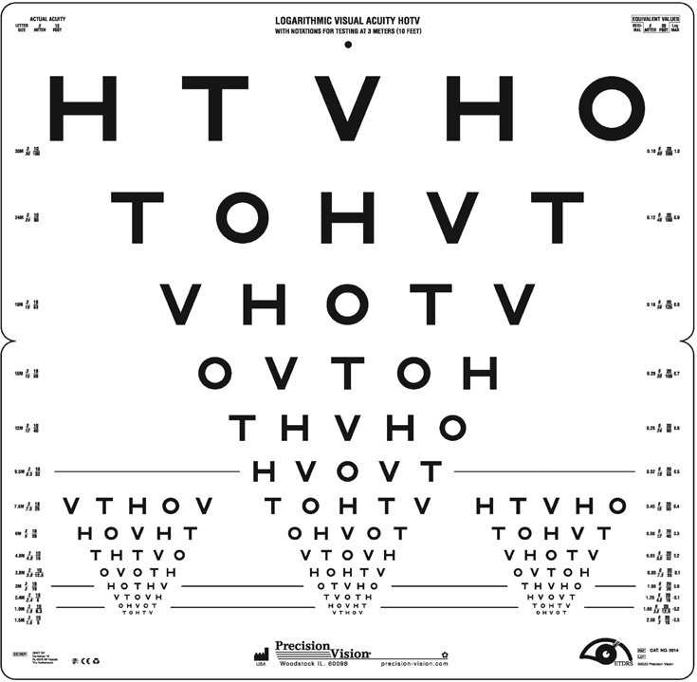
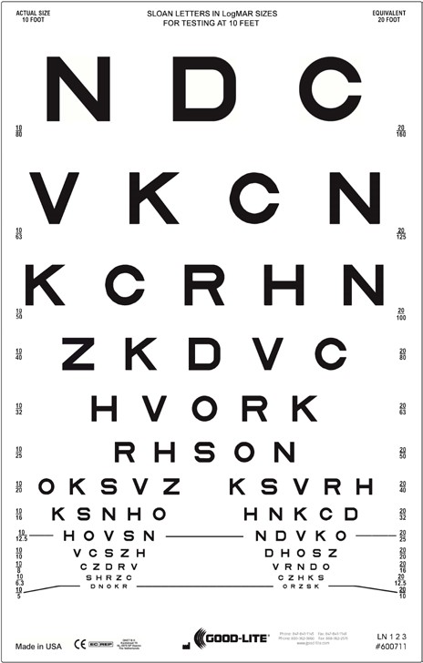
Practice: Chart Selection
Which eye chart(s) and can be used to perform a VA screening in the following situation?
(Select all that apply)
FOR TESTING AT 10 FEET FOR TESTING AT 10 FEET
20/50
20/40
20/32
20/50
20/40
20/32
B
A
12-year-old with the Threshold screening method?
4-year-old with the Threshold screening method?
3-year old with the Threshold screening method at a 10-foot distance?
5-year-old with the Critical Line screening method?
B
A
A
A
Notes:
Narrator read the question……pause…….. Then circle the answer
Add animation

Slide 50
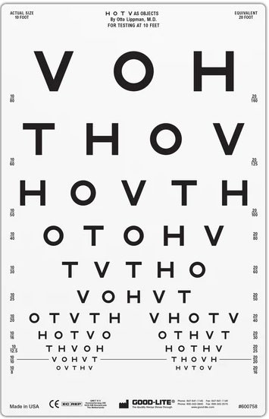

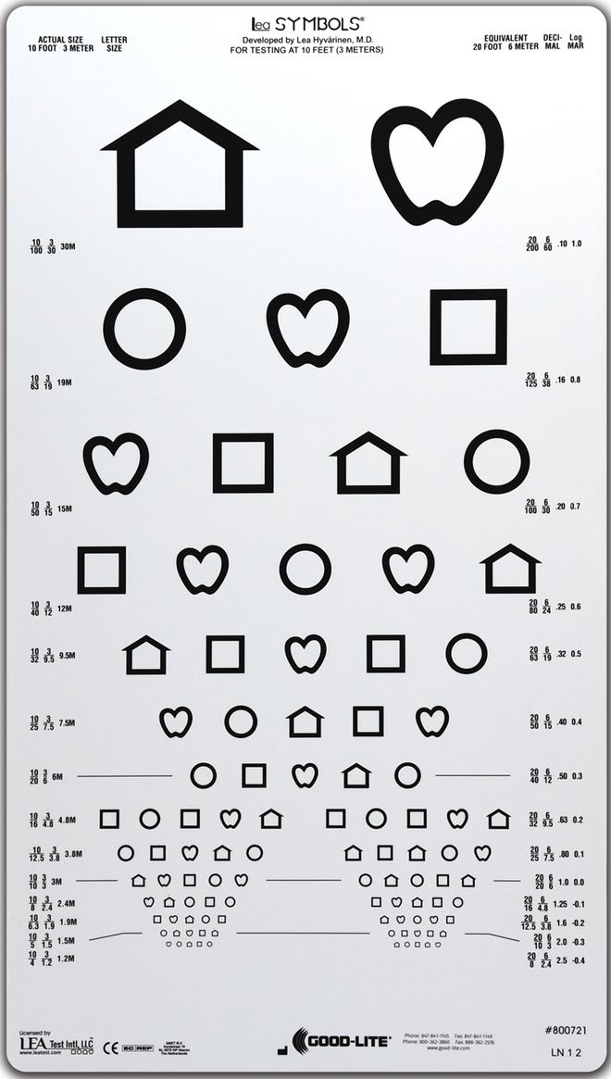

Practice: Chart Selection
Which eye chart(s) and can be used to perform a VA screening in the following situation?
(Select all that apply)
FOR TESTING AT 10 FEET FOR TESTING AT 10 FEET FOR TESTING AT 10 FEET
20/50
20/40
20/32
20/50
20/50
20/40
20/32
20/50
A B
4-year-old with the Threshold screening method?
3-year-old with the Critical Line screening method?
6-year-old that does not know their letters with the Critical Line screening method?
C
A, C
B
C
Notes:
Narrator read the question……pause…….. Then circle the answer
Add animation- ask videographer

Slide 51

Practice: Documentation
You did a Visual Acuity Screening on a 15-year-old that has prescription glasses. (see image)
How will you record the result for the Right eye?
OD 10/25 without glasses
OD 10/25 with glasses
OD 20/50 without glasses
OD 20/50 with glasses
How will you record the result for the Left eye?
OS 10/20 with glasses
OS 20/40 with glasses
OS 20/32 with glasses
OS 20/25 with glasses
Will you refer this child?
Yes
No
X
4/18/2024
Notes:
Off centered “X” need to fix. Narrator read the question……pause…….. Then circle the answer

Slide 52







Practice: VA
Screening
ACUTAL SIZE
10 FOOT
EQUIVALENT 20 FOOT
10/63
20/125
LEA SYMBOLS
ACTUAL SIZE 10 FOOT
Answer Key #250412 OD
EQUIVALENT 20 FOOT
10/50
20/100
10/40 | 20/80
10/32 | 20/63
10/25 | 20/50
10/20 | 20/40
10/16 | 20/32
10/12.5 | 20/25
10/10 | 20/20
10/8 | 20/16
10/6.3 | 20/12.5
10/5 | 20/10
10/4 | 20/8 | 63
LEA SYMBOLS
ACTUAL SIZE 10 FOOT
OS Answer Key #250412
EQUIVALENT 20 FOOT
2/15/2024
SCCPHD: CHDP PEDIATRIC VISION SCREENING
Notes:
Consider hiding this slide

Slide 53

Notes:
Thank you for your participation. If you have any feedback, questions, or concerns, please contact your Medi-Cal Managed Care health plans.

