Slide 1


Cultural Competency Training

Slide 2

Agenda
Objectives
Overview
Understanding Cultural Differences
What is Cultural Competence?
The strength of cultural competency and diversity
Cultural Competence Continuum
Communication with Culturally Diverse Patients

Slide 3

Objective
This presentation outlines specific cultural competency strategies that can be used in delivering culturally competent services to diverse populations.
We will highlight the importance of developing culturally appropriate behaviors that consider the knowledge, attitudes, and beliefs of HPSJ/MVHP members, staff, and providers.

Slide 4
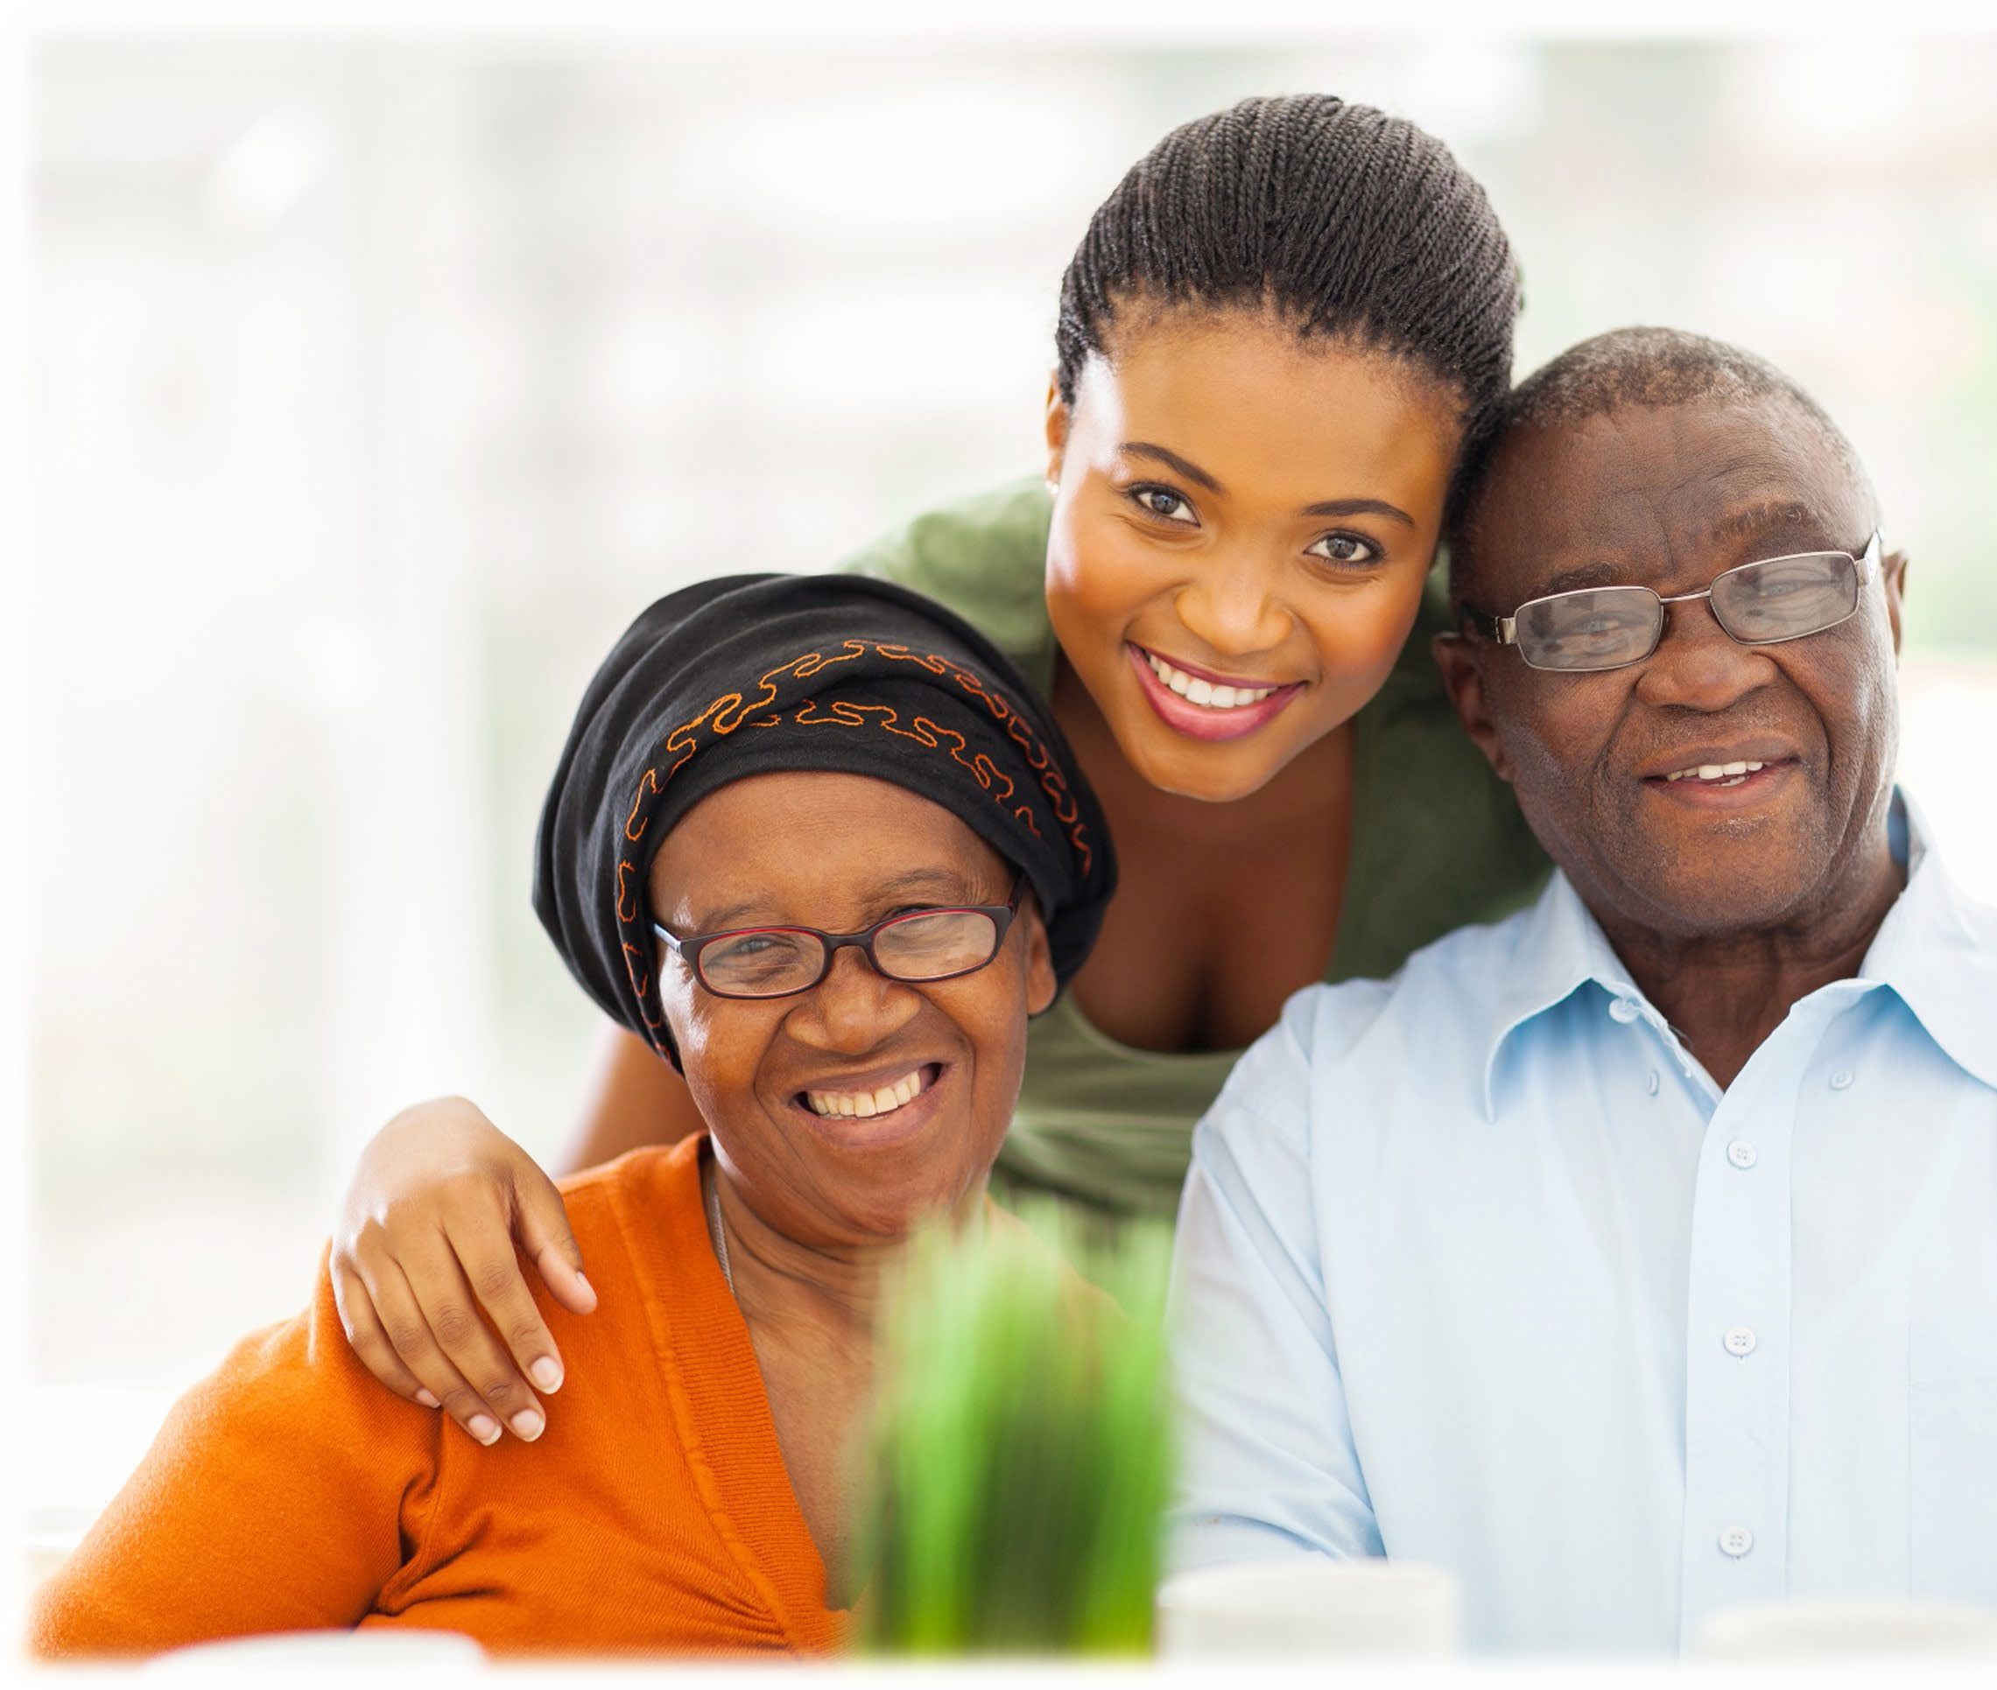
What is Diversity?
Diversity is about the differences between people within a company, teams and ecosystem.
Diversity includes characteristics such as gender, religion, nationality, race, sexual orientation, physical abilities, ethnicity and political views.
A person is not diverse, but they can bring a diverse range of experiences, e.g., appearance, likes or dislikes and identity. Seek out, embrace and value differences and similarities among staff, patients and health care providers.

Slide 5
Why is Healthcare Diversity so important?
Diversity in the workplace carries a host of benefits for healthcare providers, their staff and patients. These benefits include:
Better care for diverse population
  With a more diverse staffing model, patients can identify with them, communicate with them and their needs would be served more effectively.
Higher employee morale
  Diversity creates a stronger feeling of inclusion as a community for healthcare workers, which makes the workplace feel safer and more enjoyable.
Better patient experience and outcomes
  Patients benefit from a team that understands and relates to them. Diverse team gets better results.

Slide 6
Why is Cultural Diversity an Important Issue?
Cultural diversity is important because:
Although seniors and persons with disabilities are often refers to a single population, this is actually a diverse group of people with a wide range of needs.
44 million people 14% in the US around one in seven were born in another country.
Persons with physical and mental challenges comprise the largest minority in the U.S. with approximately 50 million individuals and almost 20% of the population.
About 14.5 million Americans 5.6% identified themselves as lesbian, gay, bisexual, transgendered, queer, intersex, asexual, or other(LGBTQIA+). Health disparity in the LGBTQIA+ community is often overlooked, and their healthcare needs may have not been fully met.
U.S. Census Bureau

Slide 7

What is Cultural Respect?
Cultural respect is critical to reducing health disparities. It helps improve access to high-quality health care that is respectful of and responsive to the needs of diverse patients.
Cultural respect enables systems, providers, and groups of professionals to function effectively to understand the needs of groups accessing health information and health care.
The National Standards for Culturally and Linguistically Appropriate Services (NCLAS) Standards are intended to advance health equity thereby influencing cultural respect as a critical element to achieving better health outcomes.

Slide 8
Why Cultural Respect is important?
Culture is often described as the combination of knowledge, belief, and behavior. It involves several elements that are often specific to ethnic, racial religious, geographic, or social groups.
This includes personal identification, language, thoughts, communications, actions, customs, beliefs, values, and institutions. As healthcare providers, it is important to recognize these elements that may influence patients’ actions or inactions surrounding health, healing, wellness, illness, disease, and delivery of health services.
The concept of cultural respect has a positive effect on patient care delivery by enabling providers to deliver services that are respectful of and responsive to the health beliefs, practices, and cultural and linguistic needs of diverse patients.

Slide 9
Understanding Cultural Differences
Do you know?
Family is defined differently by different cultures. Family includes a family of origin and family of choice.
The concept of an exact time is not used or reinforced in some cultures.
Some cultural groups stress the veneration of ancestors
Eye contact varies by culture.
Physical distance during social interactions varies by culture.
Culture greatly influences attitudes about physical contact.
Different cultures regulate the display of emotion differently
Some cultures may use different standards for loudness, speed of delivery, silence, attentiveness and time to respond to another's point.

Slide 10
What is Cultural Competence?
Cultural competence is a set of behaviors and attitudes that professionals use to:
Understand their own values and culture
Value diversity and cultural differences in their patients
Value diversity and cultural differences in their workforce
Adapt to the culture of the family or community they are serving
Work effectively in cross-cultural situations

Slide 11
Diversity includes LGBTQIA Members/Patients
LGBTQIA+ refers to lesbian, gay, bisexual, transgender, queer, intersex, asexual & all sexual & gender minority people.
Lesbian or gay is a sexual orientation that describes a person who is emotionally & sexually attracted to people of the same gender.
Bisexual is a sexual orientation that describes a person who is emotionally & sexually attracted to people of the same gender & people of other genders.
Straight (heterosexual) is a sexual orientation that describes a person who is emotionally & sexually attracted to people of a different gender.
Transgender describes a person whose gender identity & sex assigned at birth do not correspond based on traditional expectations; for example, a person assigned female sex at birth who identifies as a man; or a person assigned male sex at birth who identifies as a woman.

Slide 12
Diversity includes LGBTQIA Members/Patients
Transgender can also include people with gender identities outside the girl/woman & boy/man gender binary structure; for example, people who are gender fluid or non-binary. Sometimes abbreviated as trans.
Queer is a word that some people use to describe their sexual orientation, usually meaning that they are attracted to people of the same gender or more than one gender. The word queer is still considered derogatory to many people, but younger generations are using it more frequently to describe their own identities.
Intersex describes a group of congenital conditions in which the reproductive organs, genitals &/or other sexual anatomy do not develop according to traditional expectations for females or males. Intersex can also be used as an identity term for someone with one of these conditions.
Asexual describes a person who experiences little or no sexual attraction to others. Asexual people may still engage in sexual activity.

Slide 13
Cultural Competence Skills Include
Being aware of your own culture and values
Respecting differences
Being aware of and working at controlling your own biases and how they affect interactions with others
Understanding institutional barriers that prevent some families from accessing resources
Building strong cross cultural team relationships
Advocating for individuals who are different from yourself
Using effective communication skills across differences
Mediating cross-cultural conflicts
Being flexible

Slide 14
Don’t Assume!
The assumptions we make based on a person’s appearance often led to misjudgments.
We may not “hear” what youth and families have to say because we have already decided that they have nothing to contribute based on our own biases relating to the person’s appearance or situation.
Our preconceptions may adversely affect our ability to communicate effectively with those who are different from us.

Slide 15
Labeling
We often use labels or categories to describe others.
These labels can be based on such characteristics as clothing, looks, the way a person talks, or the groups to which he or she belongs.
Grouping is a natural human inclination; however, people often make assumptions about groups of people they don’t even know.

Slide 16
Stereotyping
Preconceptions and Stereotypes function as negative lenses through which people perceive others who look, think, or behave differently.
Stereotyping occurs when we use misinformation to judge everyone who belongs to a specific group.
o For example, if we are walking through a park late at night and encounter three senior citizens wearing fur coats and walking with canes, we may not feel as threatened as if we were met by three high school-aged boys wearing leather jackets. Why is this so? Because we have made a generalization in each case.
Stereotypes also evolve out of fear of persons from minority groups.

Slide 17
To Avoid Stereotyping
Acknowledge the existence of your own preconceptions.
Be critical of yourself. Don't take for granted any opinion that pops into your head.
Work to understand how your preconceptions impact the way you view others.
Know your labels and to whom you relegate them.
Slow down and get more information.

Slide 18
The Strengths of Cultural Competence and Diversity
The ability to collaborate effectively with individuals from different culture to improve health care experiences and outcomes.
Offers an environment of inclusion, that is supportive and collaborative and increases productivity and loyalty.
Promotes equity to alleviate healthcare disparities and improve health care outcomes in these patient populations.
Encourages interaction among diverse people to enrich the educational experience, promote personal growth and enhance the community.
Fosters mutual respect, value differences and promotes cross cultural understanding.
Prepares community members to live and work in a competitive global economy.

Slide 19


Cultural Competence Continuum
Cultural competence at the organizational and individual levels is an ongoing developmental process.
Cultural Proficiency
Cultural
Competence
The following chart is designed to highlight selected characteristics that organizations may demonstrate along the stages of the cultural competence continuum.
Cultural
Pre-Competence
Cultural Blindness
Cultural Incapacity
Cultural Destructiveness

Slide 20

Communication with Culturally Diverse Patients
When you work with culturally diverse populations:
Learn culturally specific information.
Know some words and phrases in the patient’s language.
Use trained interpreters who can interpret language as well as cultural cues.
Limit the number of forms and other paperwork.

Slide 21
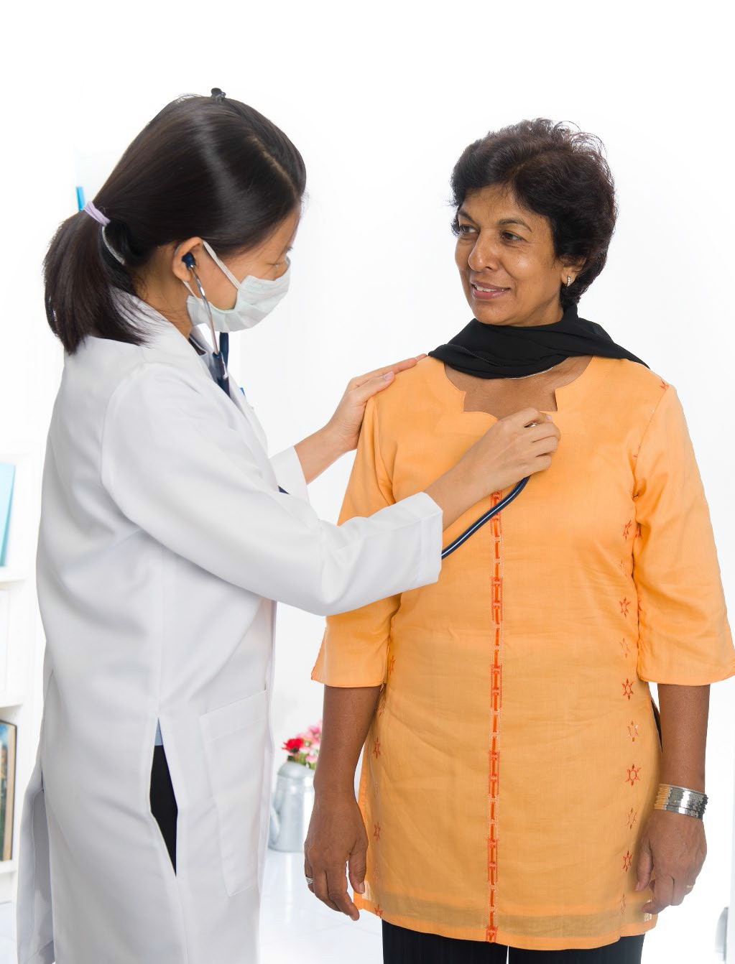
Do’s of communicating with Limited-English Speakers
Make your statements as specific as possible
Let the person see your lips as you speak
Be aware of your assumptions
Don’t rush – be patient
Speak a little more slowly but not more loudly
Be careful with your pronunciation
Stick to the main points
Avoid jargon

Slide 22

Do’s of communicating with Limited-English Speakers
Emphasize key words
Use simple sentence structure
Keep pencil and paper handy and write key information down
Use body language to illustrate what your words say
Ask the person to write down any words you have difficulty understanding

Slide 23

Quiz Time!
Which of the following characteristics are included in diversity?
Ethnicity
Religion
Race
Gender
All of the above
21

Slide 24
Quiz Time!
Which of the following is a reason why healthcare diversity is so important?
Better care for diverse population
Higher employee moral
Better patient experience and outcomes
All of the above

Slide 25
Quiz Time!
44 million people in the US around one in seven were born in another country.
True
False

Slide 26
Quiz Time!
Which of the following skills are included in cultural competence?
Being flexible
Respecting differences
Being aware of your own culture and values
Using effective communication skills across differences
All of the above

Slide 27
Quiz Time!
Stereotyping occurs when we use misinformation to judge everyone who belongs to a specific group.
True
False

Slide 28
Quiz Time!
Which of the following are Do’s of communicating with Limited English speakers?
Emphasize key words
Speak faster and loudly
Make your statements as specific as possible
Both a and c

Slide 29
Summary
Striving for ethnic diversity and cultural competency in health care is necessary to adequately care for an evolving and diverse patient population.
It is imperative that providers adopt evidence-based practices to foster cultural competency including promoting recruitment of diverse healthcare-providers, the use of interpreter services, cultural competency training for healthcare team members, and distribution of information on cultural competency to hospital staff members. As population demographics change, providers must also evolve to suit the needs of HPSJ/MVHP diverse patients.

Slide 30

Thank You
DUALCULTCOMPTRNG07232024E

