Slide 1
Continuity of Care 2024 Transition

Slide 2
Transition Continuity of Care
CoC for Providers Member can keep their provider even if the provider is out of network for the receiving plan
CoC for Covered Services Member can continue an active course of treatment - receiving plan must honor prior authorizations from the previous plan
CoC Coordination/Care Management Previous plan and Receiving plan work together to transfer additional supportive information (e.g., care plans)
Additional Continuity of Care Protections for All Transitioning Members - Durable Medical Equipment (DME) rentals and medical supplies, nonemergency medical transportation (NEMT), non-medical transportation (NMT), and scheduled specialist appointments

Slide 3
Continuity of Care for Providers
Transitioning members may request CoC for Providers for up to 12 months, if:
The provider is rendering a service eligible for Continuity of Care for Providers
Member has a Pre-Existing Relationship with an eligible provider
(at least one non-emergency visit during the preceding 12 months);
Provider is willing to accept HPSJ contracted rates or FFS rates
Provider meets HPSJ’s applicable professional standards and has no disqualifying quality of care issues; and
Provider is California Medicaid State Plan approved
Notes:
The member, Authorized Representative, or provider must request CoC for Providers
Retro CoC request- the requester must contact the Receiving MCP within 30 calendar days after the date of service. Retro requests cannot be urgent or immediate
HPSJ must accept requests made over the telephone, electronically, or in writing

Slide 4
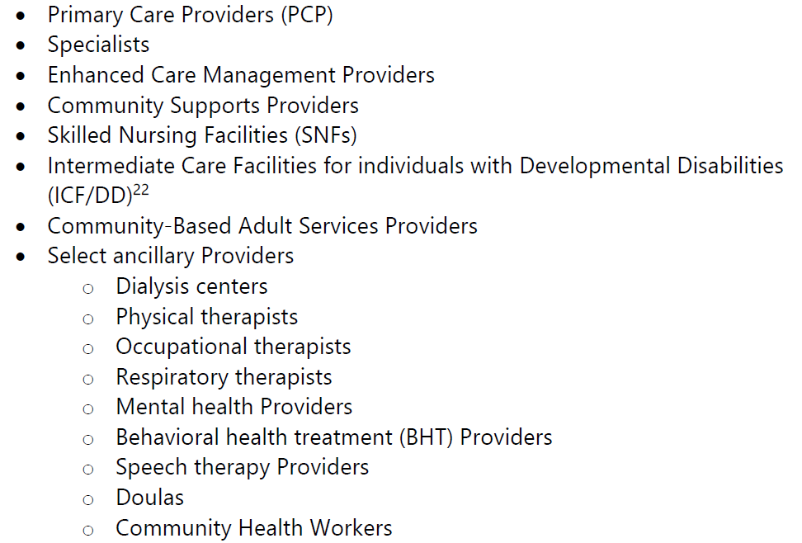
Eligible Provider Types
Notes:
Examples of Ineligible Provider Types
• All other ancillary Providers, such as:
o Radiology
o Laboratory
o Non-emergency medical transportation (NEMT)
o Non-medical transportation (NMT)
o Other ancillary services
• Non-enrolled Medi-Cal Providers

Slide 5
Standard Processing Timeframes
Type | Definition | Processing | Notification to Provider and member
Urgent | Risk of harm to the member | As soon as possible, but no more than 3 calendar days | Timeframe appropriate for member’s condition, no more than 3 calendar days
Immediate | Member needs more immediate attention (provider appointment or other services) | 15 calendar days | 7 calendar days
Non-Urgent | Member does not qualify for immediate or urgent status | 30 calendar days | 7 calendar days

Slide 6
Continuity of Care for Services
Transitioning members may continue receiving covered services after January 1, 2024.
Must honor Prior Authorizations for six months or until HPSJ reassesses (Jan 1- Jul 1, 2024)
When data is received from DHCS/previous plan, or
When requested by the member, AR or provider
Must allow continuation of an “Active Course of Treatment” without prior authorization for six months.
Must ensure coordination of care for members Accessing the Transplant Benefit and members in Inpatient Care
Coordination and hand off to HPSJ for Complex Case Management
Notes:
The member, Authorized Representative, or provider must request CoC for Providers
Retro CoC request- the requester must contact the Receiving MCP within 30 calendar days after the date of service. Retro requests cannot be urgent or immediate
HPSJ must accept requests made over the telephone, electronically, or in writing
Active Course of Treatment is defined as a course of treatment in which a member
is actively engaged with a provider prior to January 1, 2024 and following the
prescribed or ordered course of treatment as outlined by the provider for a
particular medical condition.38 An Active Course of Treatment to be honored by the
Receiving MCP should be documented in utilization or authorization data
transferred to the Receiving MCP or other documentation.

Slide 7
Durable Medical Equipment
Must allow members to keep DME rentals/medical supplies from their existing providers for 6 months, or until authorization reassessed:
May switch member to a contracted vendor after reassessment
Reassessment can be done at any time
If HPSJ does not complete a new assessment, authorization remains in effect for the duration of the original treatment authorization
Notes:
, (including those arranged for, but not yet delivered)

Slide 8
Transportation (NMT/NEMT)
HPSJ must honor all prior authorizations approved by previous MCP for ongoing transportation needs, including the mode of transportation.
Accept and process member request for NEMT/NMT before January 1, 2024,
Confirm a network provider is able to deliver the scheduled NEMT/NMT services, or arrange for the services by another network or OON provider without disruption

Slide 9
Scheduled Specialist Appointments
If a member has an appointment with a Specialist they have not yet seen under their Previous plan, a member may request an appointment with a network specialist within the same timeframe as their scheduled appointment.
If HPSJ cannot arrange for an appointment with a network provider on or before the scheduled appointment, we must allow the member to keep their appointment with the OON provider.

Slide 10
Special Populations
HPSJ must implement CoC for members of “Special Populations” through outreach to members’ providers and data transfer between HPSJ and CA Health and Wellness.
HPSJ will receive data from DHCS and the previous plan that flags members in a Special Population.
Notes:
Alpine- 1 member
El Dorado ~3000 members

Slide 11
List of Special Populations
• Authorized to receive ECM or CS
• Receiving Complex Care Management
• Enrolled in 1915(c) waiver programs18
• Receiving in-home supportive services (IHSS)
• Children and youth enrolled in California Children’s Services (CCS)/CCS Whole Child Model
• Children and youth receiving foster care, and former foster youth through age 25
• In active treatment for HIV/AIDS, tuberculosis, or hepatitis B and C
• Taking immunosuppressive medications, immunomodulators, and biologics
• Receiving treatment for end-stage renal disease (ESRD)
• Living with an intellectual or developmental disability (I/DD) diagnosis
• Living with a dementia diagnosisAre
• In the transplant evaluation process, on a waitlist to receive a transplant,
undergoing a transplant, or received a transplant in the previous 12 months

Slide 12
List of Special Populations (cont.)
• Pregnant or postpartum (within 12 months of the end of a pregnancy or maternal mental health diagnosis)
• Receiving specialty mental health services (adults, youth, and children)
• Receiving treatment with pharmaceuticals whose removal risks serious withdrawal symptoms or mortality
• Receiving hospice care
• Receiving home health
• Residing in Skilled Nursing Facilities (SNF)
• Residing in Intermediate Care Facilities for individuals with Developmental Disabilities (ICF/DD)
• Receiving hospital inpatient care
• Post-discharge from inpatient hospital, SNF, or sub-acute facility on or after December 1, 2023
• Newly prescribed DME (within 30 days of January 1, 2024)
• Members receiving Community-Based Adult Services

Slide 13
Transplant Members
Must contract with CA Health and Wellness’ network Center of Excellence (COE) Transplant Programs for members in any phase of transplant.
If unable to contract, to establish an LOA CoC for Providers a with the hospital where a Transplant Program is located.

Slide 14
Early Access to Assistance
HPSJ must be ready to accept calls from members by November 1st to assist members with CoC requests prior to enrollment.
If CoC criteria are met, HPSJ must:
Attempt to contract with the OON Provider, or
Attempt to execute an LOA for CoC for up to 12 months, unless shorter time agreed to by provider and HPSJ
If a request is made before January 1, 2024, then HPSJ must complete processing the request by January 1, 2024, or according to required timeframes, whichever is later.

Slide 15
Prior authorization for CoC
To submit an authorization request, visit our online portal https://provider.hpsj.com/dre/default.aspx
Authorization form is also available at Forms & Documents for HPSJ Providers

Slide 16
References
California Health and Safety Code Sections 1363, 1373.96 &1374.73
California Welfare and Institutions Code, Section 14094.13
Department of Health Care Services (DHCS) All Plan Letter (APL) 22-032 Continuity of Care
Department of Health Care Services (DHCS) All Plan Letter (APL) 18-008 Continuity of Care for Medi-Cal Members Who Transition into Medi-Cal Managed Care (Revised)
DHCS APL 21-003 Medi-Cal Network Provider and Subcontractor Terminations
DHCS APL 22-018 Skilled Nursing Facilities Long Term Care Benefit Standardization and Transition of Members to Managed Care
HPSJ Contract with the Department of Health Care Services (DHCS) for Medi-Cal
DHCS Transition policy guide:
https://www.dhcs.ca.gov/Documents/Managed_Care_Plan_Transition_Policy_Guide.pdf

